Slide 1


enabling & connecting at-scale
Kandi Tillman
Managing Co-Founder

Slide 2
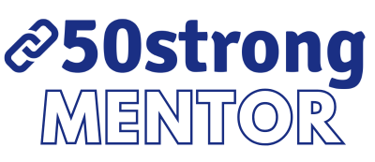

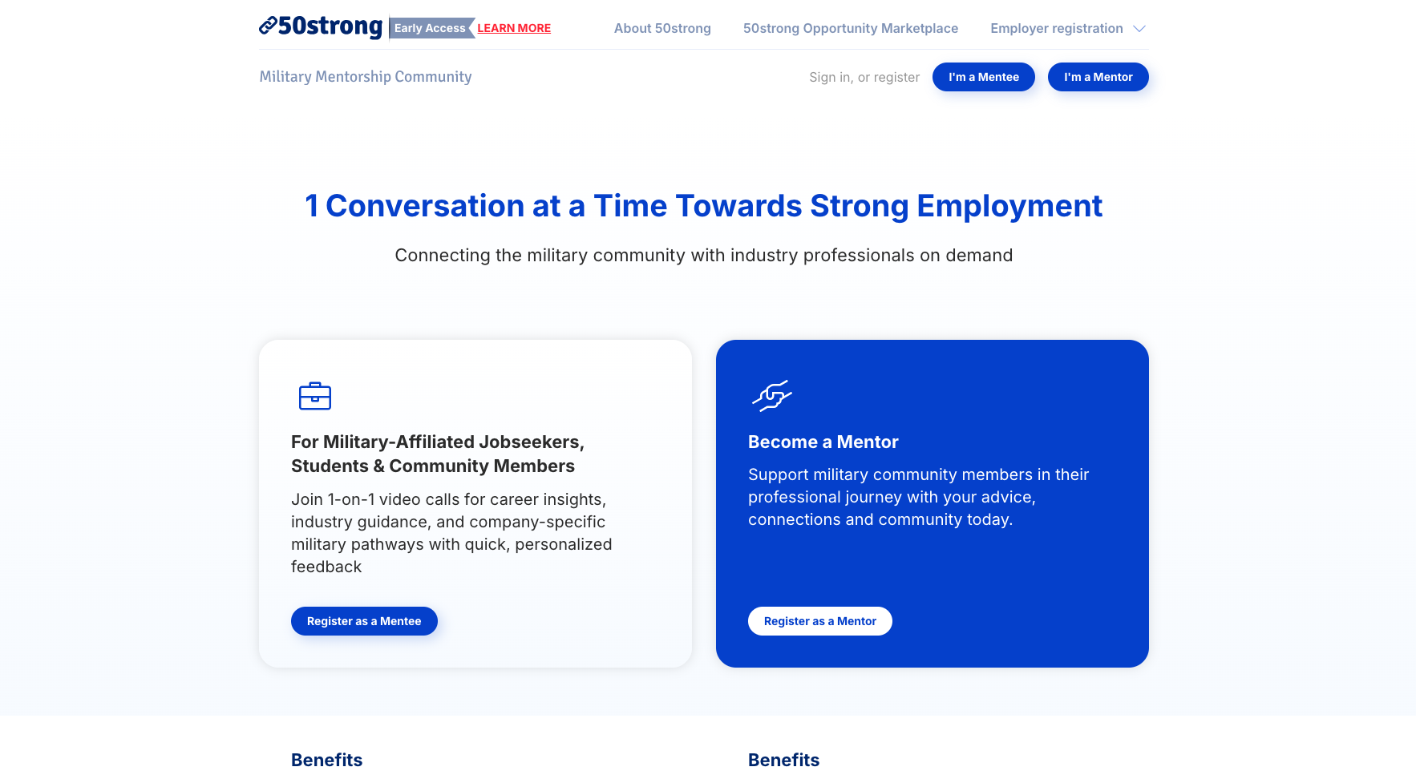

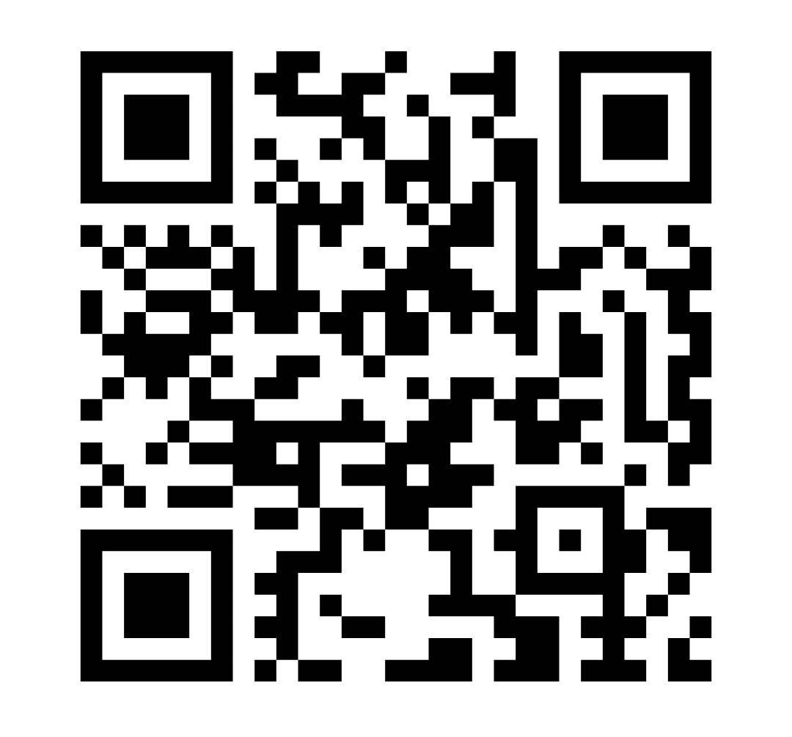
1 Conversation at a Time Towards Strong Employment
Easy, Casual, Virtual
1:1 conversations with industry professionals
https://50-strongmentor.us/
Early Access Now Available

Slide 3
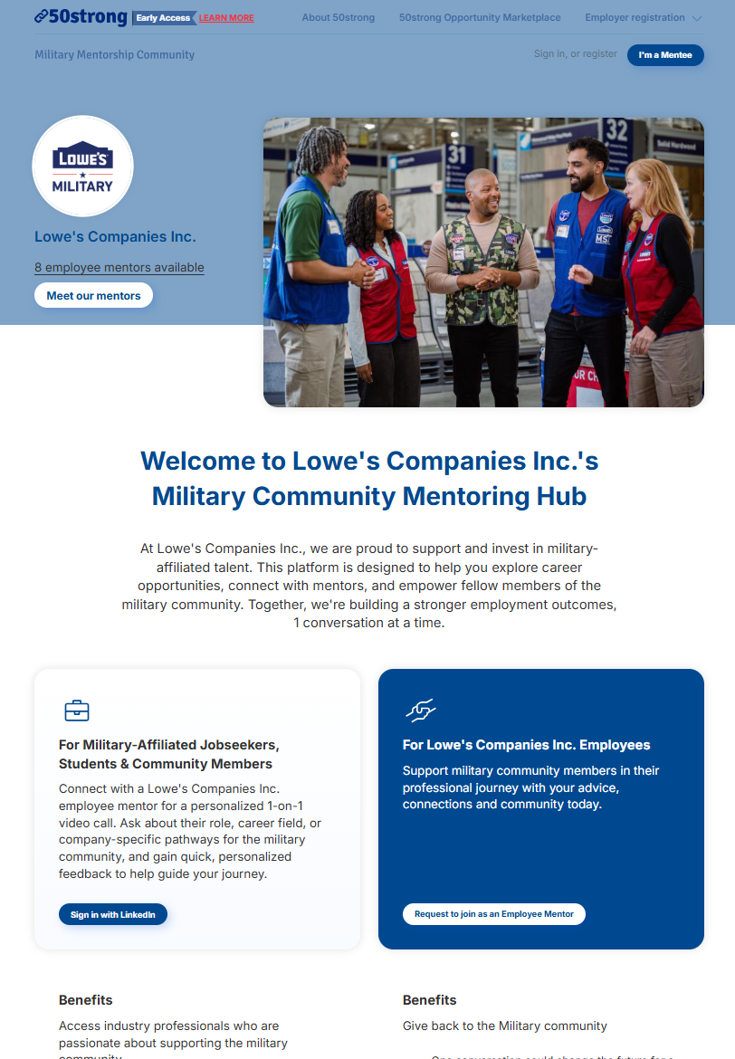
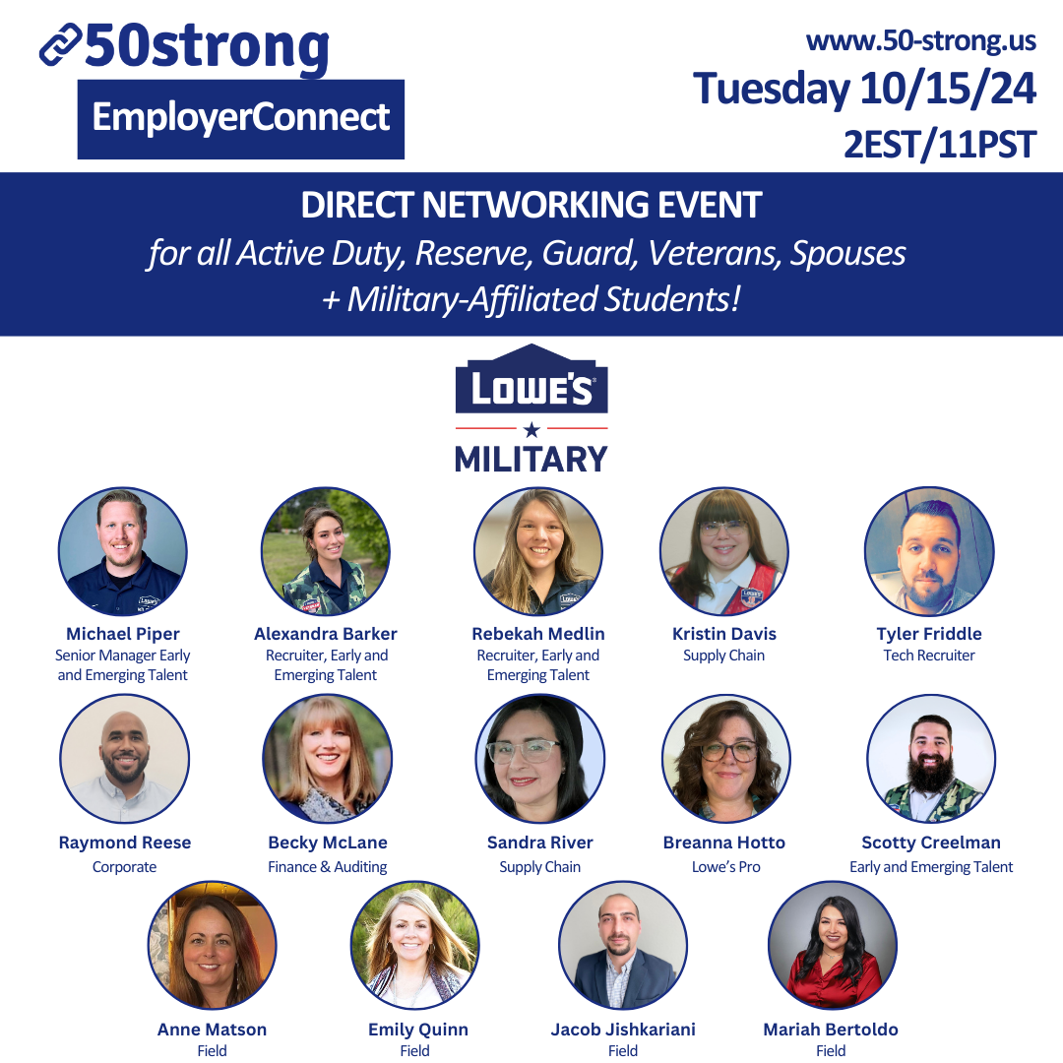
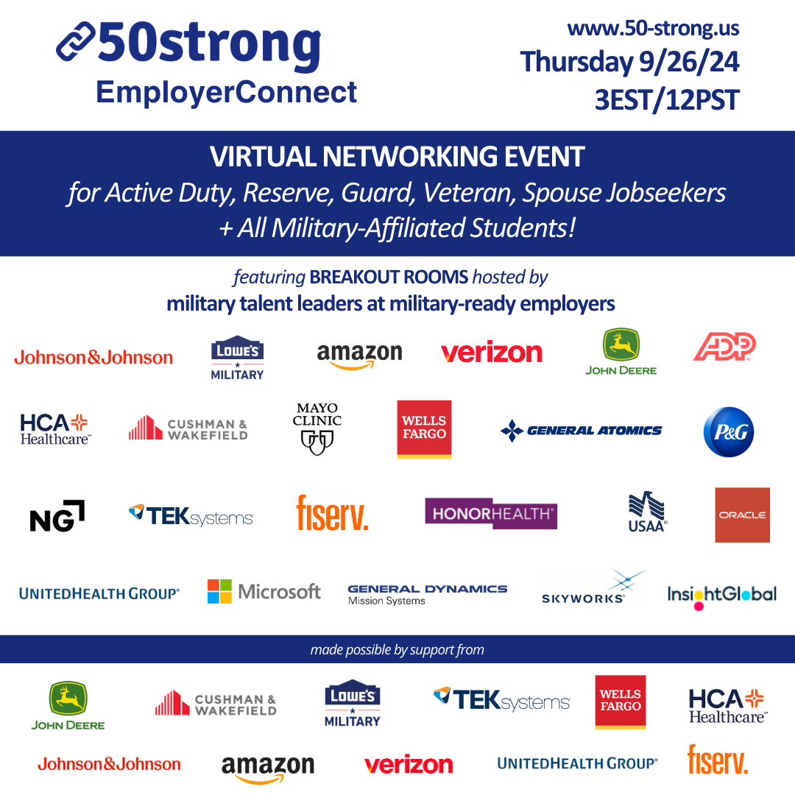
Stronger Employee & Talent Engagement
Unlimited Employees
individually-determined, on-demand
for each employee’s schedule & interests
10-15 Employees
periodic, pre-planned
company-specific deeper dive
2-3 Recruiters
periodic
at-scale, industry-led employment mentoring

Slide 4
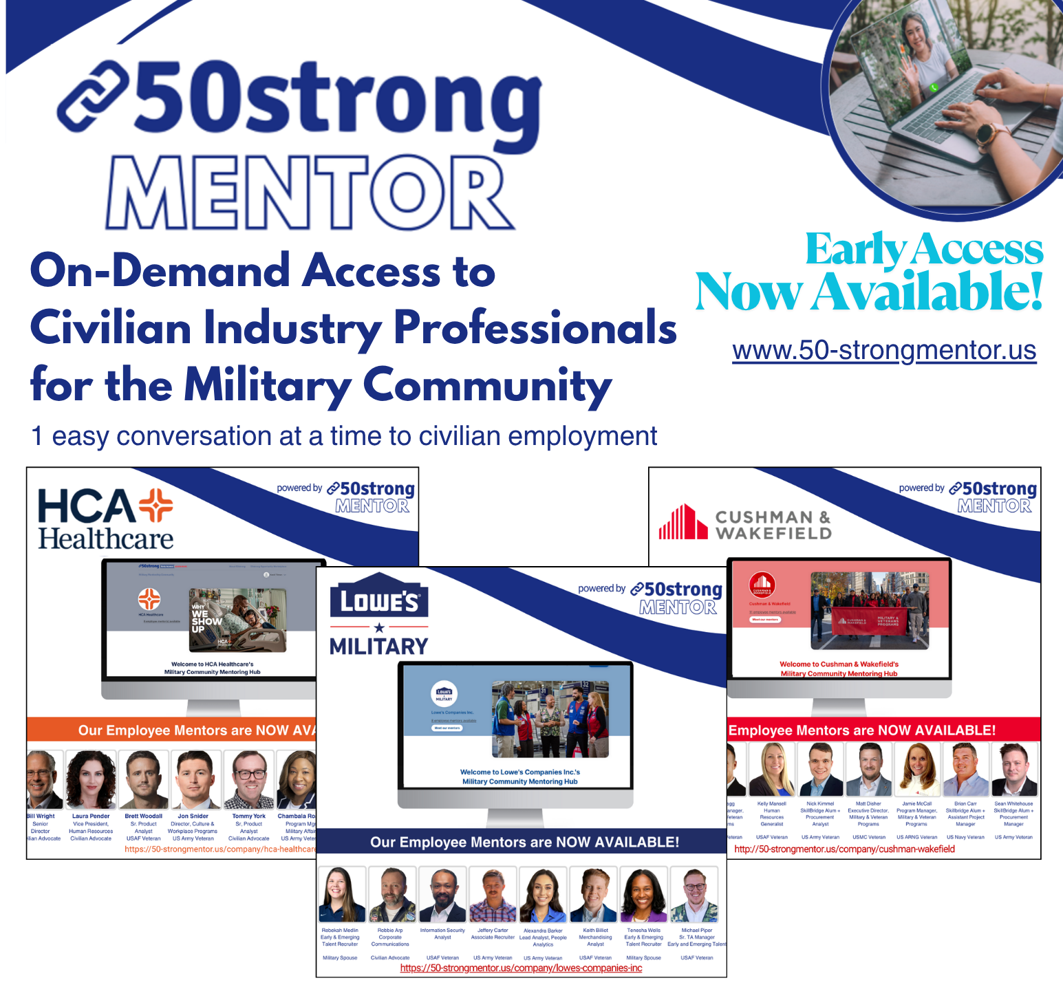
Empowering Military Talent
1:1 virtual mentorship
Direct access to industry professionals
Connect with top military employers
Mentorship tied to talent acquisition
Flexible, on-demand scheduling
No long-term commitment
real-time access to employee & community volunteers
that are eager to answer questions, share what they do, review resumes
& offer referrals to military talent teams

Slide 5
Current Early Access Partners
Corporate Partners
Cushman & Wakefield, John Deere, Lowe’s, Fiserv, HCA Healthcare, Oracle, Navy Federal Credit Union, UnitedHealth Group, Vestas, CVS Health + 3 others coming soon
Higher Education
University of Central Florida, Villanova, William & Mary, Austin Peay State University
Non-Profit Organizations
Hiring Our Heroes, Service To School
Business Chambers / Industry Associations
North San Diego Business Chamber, Enterprise Wireless Alliance
Interested in joining us? Please reach out to our team!
Notes:
11 employers, 4 HE, 1 NP, 2
we are onboarding 2 other reputable nonprofits

Slide 6
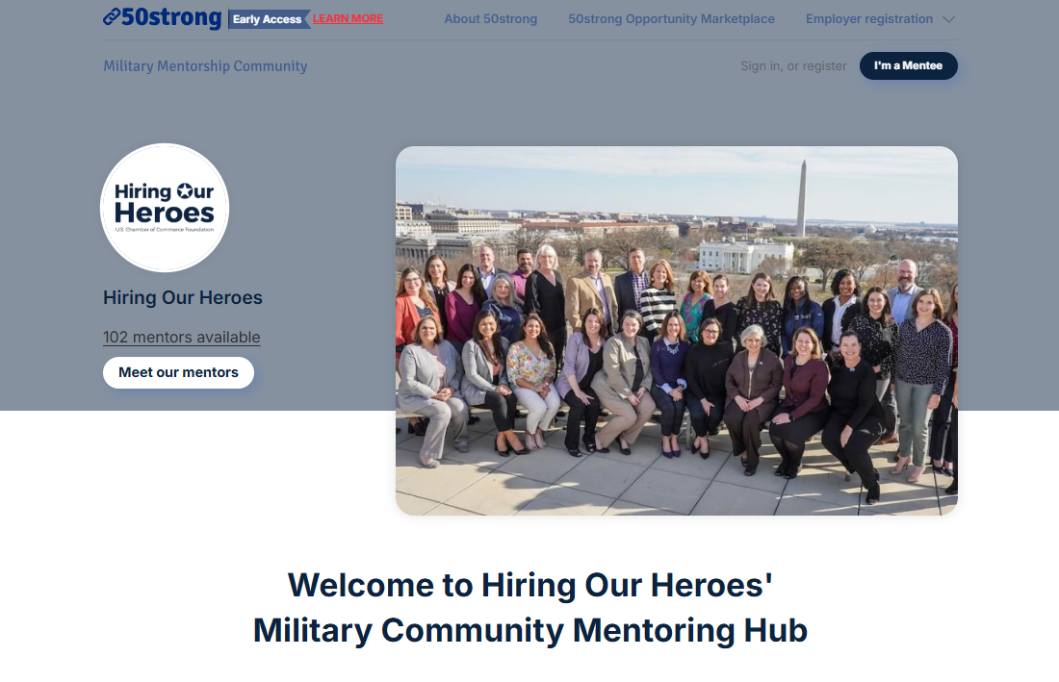
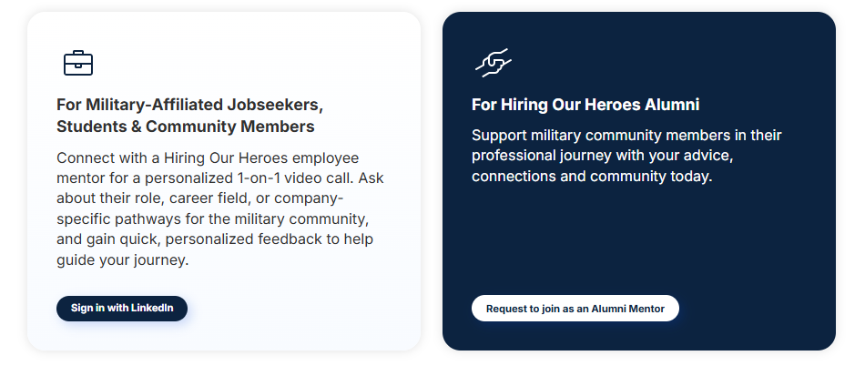
How We’re Collaborating with HOH
piloting for HOH CFP 26-1
this Fall with
2 HOH Mentor Power Weeks
real-time access to HOH CFP Alumni Mentors
that are eager to answer questions, share what they do
& offer insight into HOH CFP candidates

Slide 7
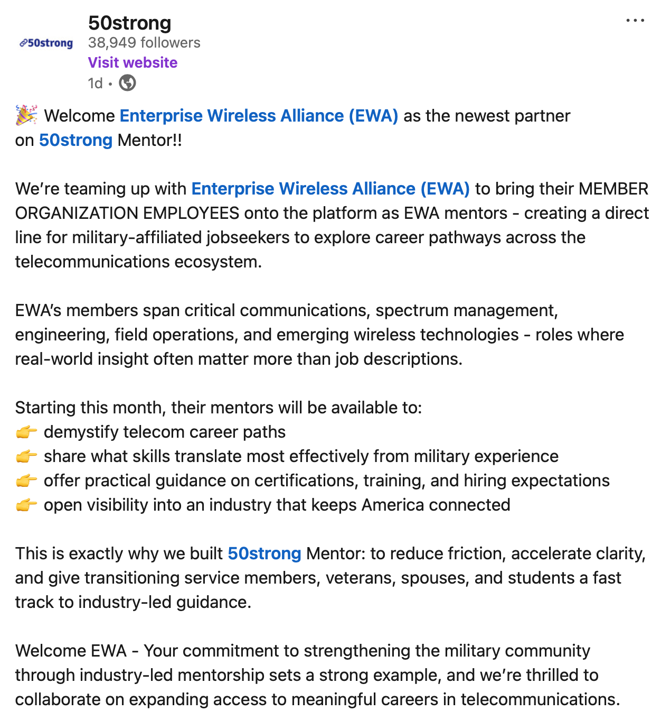
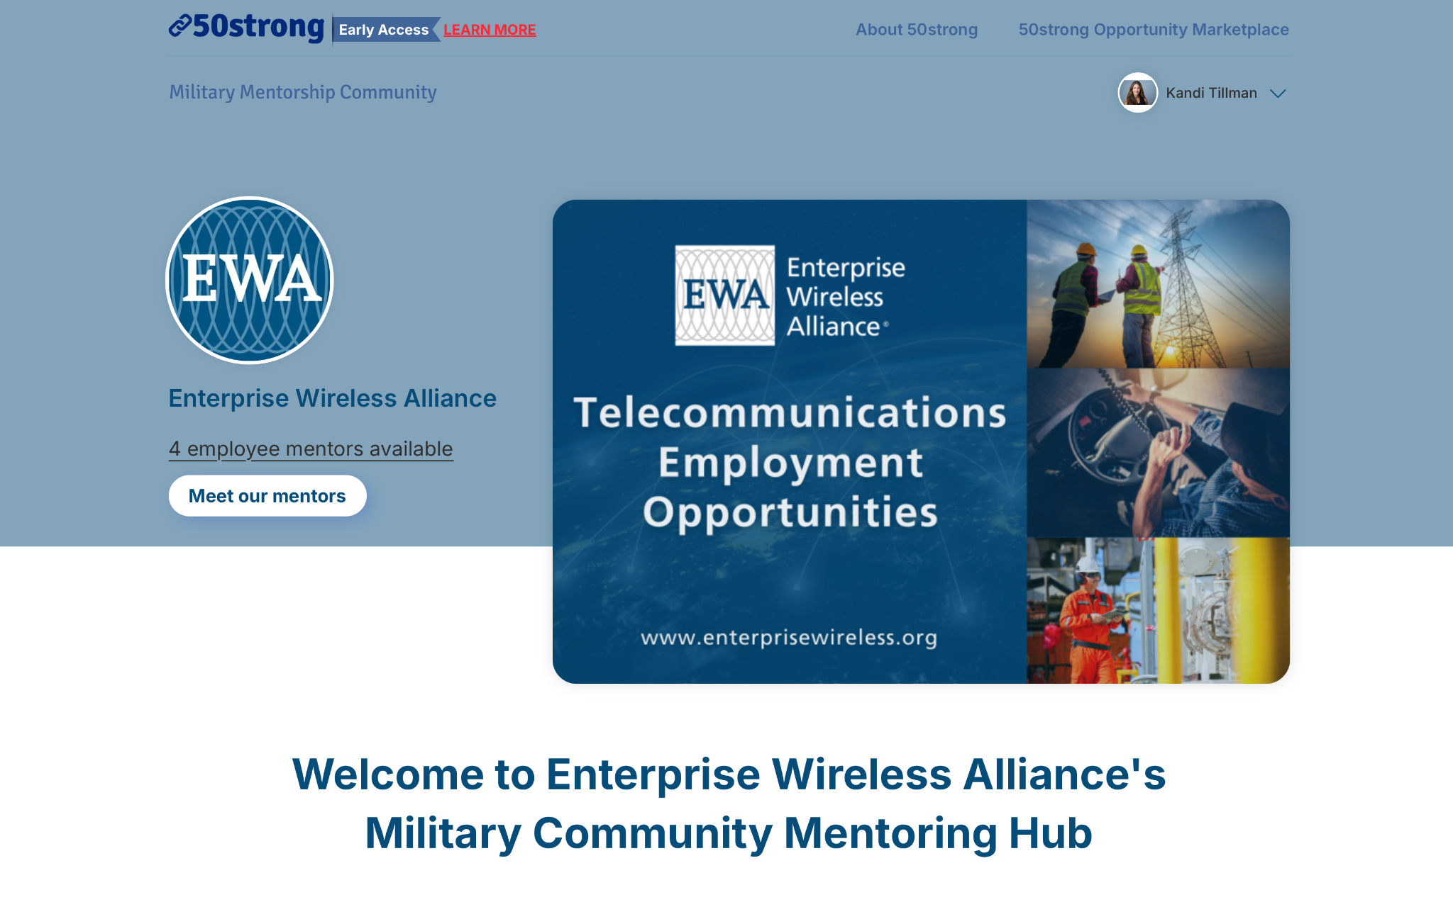
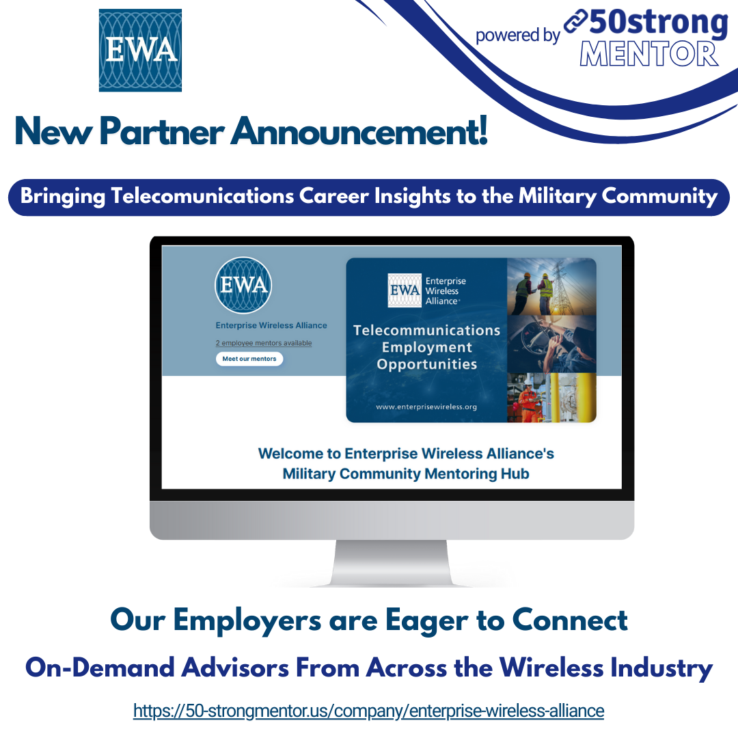
How We’re Collaborating with EWA
real-time access to Member Employee Mentors
that are eager to answer questions,
share what they do
& offer insight

Slide 8
1 Conversation at a Time Towards Strong Employment
Easy, Casual, Virtual
1:1 conversations with industry professionals
https://50-strongmentor.us/
Early Access Now Available

