Slide 1


enabling & connecting at-scale
Kandi Tillman
Managing Co-Founder

Slide 2
SkillBridge for Transitioning Military:
Activated by Industry
“...an opportunity for service members to gain valuable civilian work experience through specific industry training, apprenticeships, or internships during the last 180 days of service...
For industry partners...an opportunity to access and leverage the world's most highly trained and motivated workforce at no cost...
industry partners offer real-world training and in-demand work experience while having the opportunity to evaluate the service member's suitability for future employment.”
2-5 months for employers
to train, assess & onboard strong talent
while DoD pays salary
=
BUSINESS IMPACT
Source: https://skillbridge.osd.mil/program-overview.htm

Slide 3
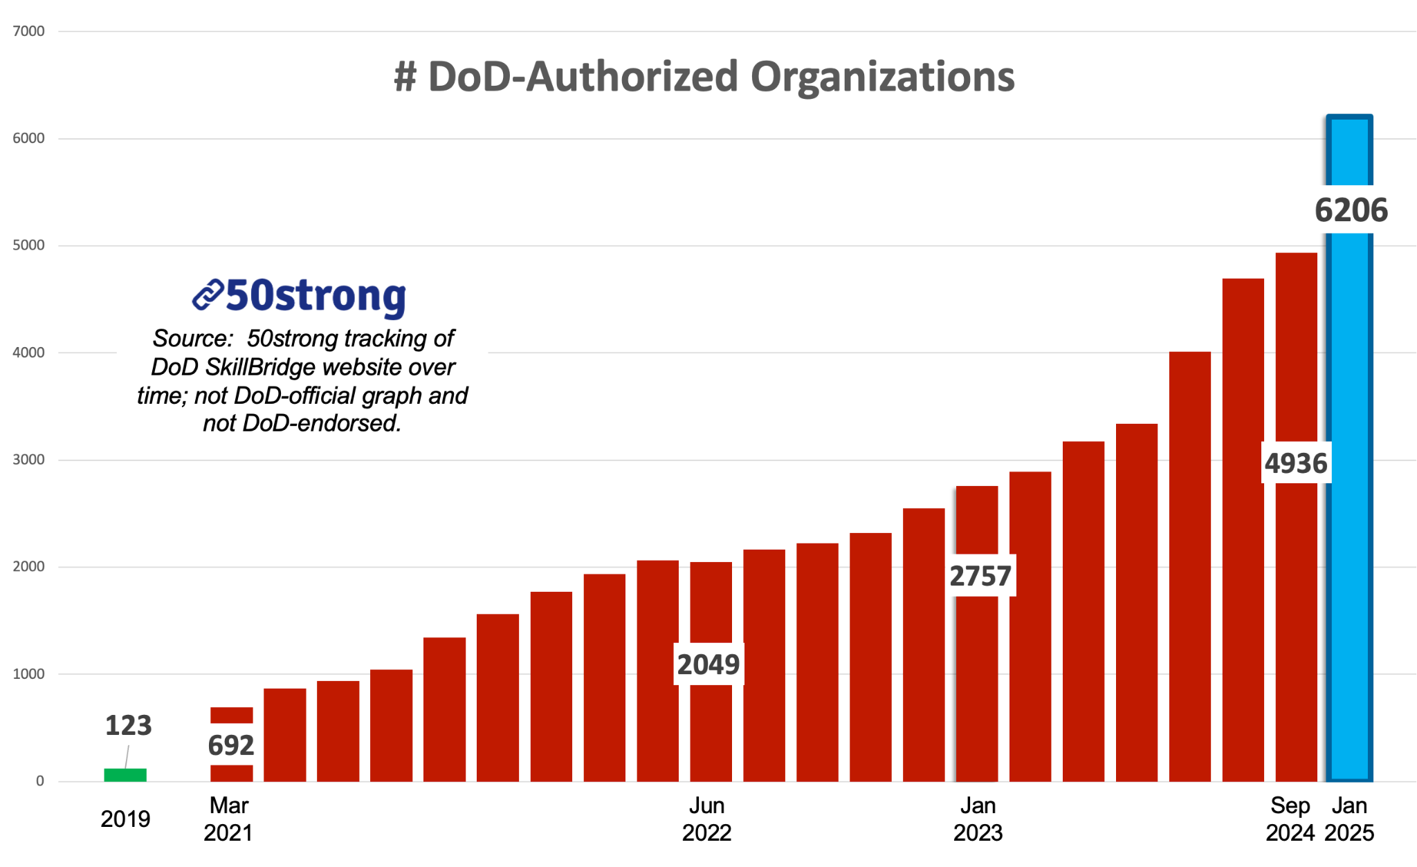
SkillBridge for Transitioning Military: Rapid 5-year Industry Growth
4022
Dec
2025

Slide 4
SkillBridge Stakeholders
DoW &
Services
Industry Partners ACTIVATE SkillBridge opportunities.
Individual Commands approve each participation.
When Industry Partners demonstrate a focus on best practice employment outcomes, we drive trust among other stakeholders.
Industry Partners
Individual Commands
Transitioning
Service Members
Authorized by Congress. Facilitated by MCTO.
Approved by Commands. ACTIVATED BY INDUSTRY PARTNERS.

Slide 5
Some Latest News
Much-needed boundaries announced in 2024.
3rd Party facilitation through March 2026. (extended in mid 2025)
Two enrollment periods for new employers.
Every employer needs an MOU.
Each employer is responsible for their outreach.
Reporting requirements are underway.

Slide 6
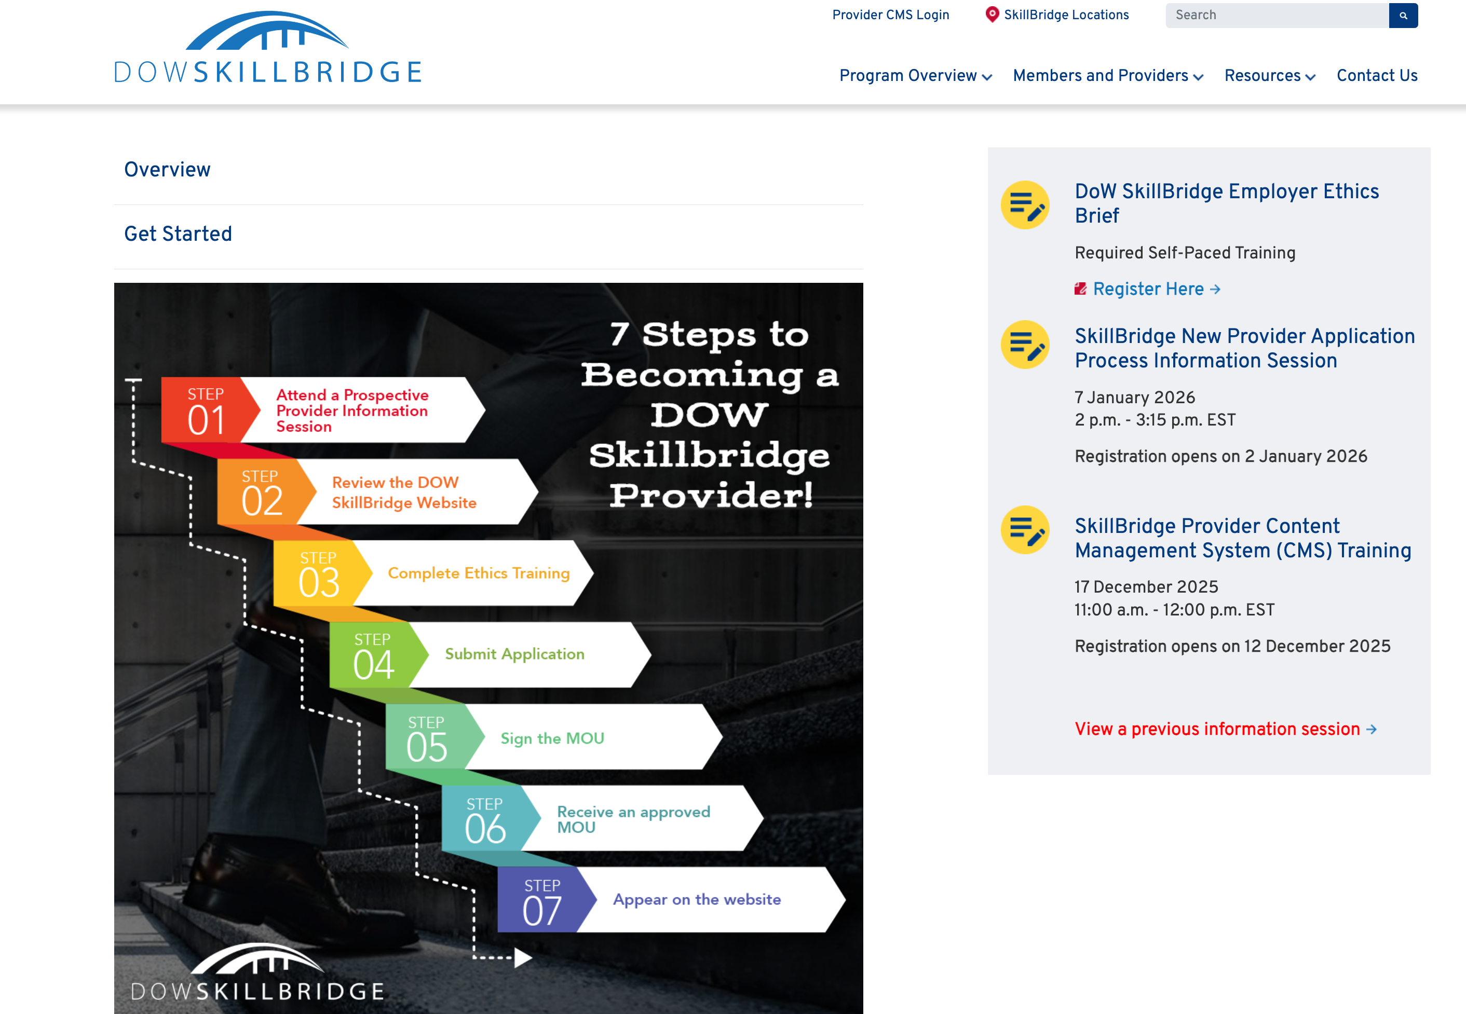
For Initial Information
Source: https://skillbridge.osd.mil/industry-employers.htm

