Slide 1


Leading with Purpose:
Hiring and Retaining Military-Connected Talent
Presented By
Dr. Bruce Huntley, ACC
Elvicore Elevate, Speaking and Workshops
“I help leaders lead by design, aligning what matters with daily decisions.”
The Elvicore Group • www.elvicore.com • LinkedIn @ Dr. Bruce L. Huntley

Slide 2
Design Framework
Values
Decisions
Routines
Results
Leading By Design
This framework emphasizes how:
1. Values into Decisions
2. Decisions into Routines
3. Routines into Results

Slide 3

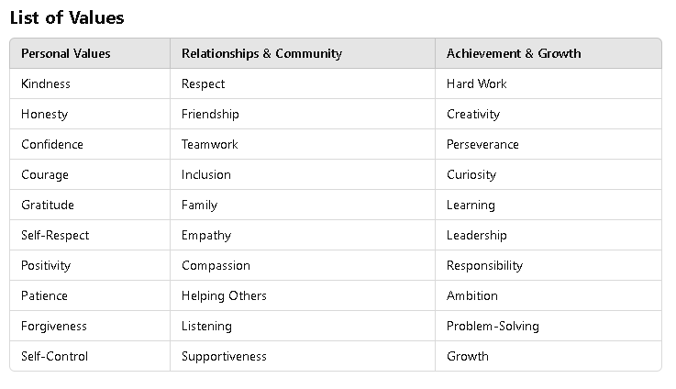



Values to Decision
Goal: Choose a Value Name a Decision Define a Success Signal
Name a Decision
Articulate a specific decision that needs to be made.
Success Signal
Define what success looks
like within 30 days.
Metrics
“Write it. Don’t overthink it.”

Slide 4



Examples and Success Signals
Quick Steps
Crosswalk Strategy
Bridging Military Experience
Buddy and/or Sponsor
Supportive Onboarding System
Structured Interviews
Consistent Hiring Process
BH

Slide 5

Purpose Cue
A Simple Three Line Guide
Value:
Stewardship
The filter used to decide how and what we see in ourselves, others, and the world.
Why Now:
Skill-based Resources
Establishing a sense of urgency is crucial to gaining needed co-operation.
“The values you choose quietly guide
the way you lead, live, and show up
for yourself and others.”
- Dr. Bruce Huntley
Next Move:
Portable or Gig roles
Create a vision and strategy to direct our ideas or actions as we decide how or what we want to see.

Slide 6
Purpose Cue Examples
Three Examples
Value: Respect
Why Now: Requisition Volumes Rising
Next Move: Pilot structured interviews with two
service scenario questions in the next loop.
Value: Accountability
Value: Belonging
Why Now: Hand offs stalling
Why Now: Early exits rising
Next Move: Close every meeting with owners and
dates – review once a week and adjust.
Next Move: Assign a buddy and/or sponsor for every
new hire, review touchpoints at day 15.
Underline the verbs in your cue, as they become your actions.

Slide 7
Hire Levers:
Three Moves to Start This Month
Add MOS-to-Skills crosswalks to postings -
- Implementing a crosswalk helps connect military experiences with job
requirements, ensuring that candidates are evaluated on relevant
skills and competencies rather than traditional job titles.
Use structured interviews –
- Using structured interviews with service relevant scenarios standardizes the hiring
and promotes fairness and provides a clearer comparison of candidates' qualifications.
Selection brief –
- A selection brief names the guiding value on the decision memo, shows how the value shaped
the hire, and can align the assessments with organizational goals.
What Metrics are you going to use to Signal Success?

Slide 8




Onboarding Levers
Make the First 30 Days Count
Buddy System
Day-zero welcome, named buddy and sponsor, communicate both in the offer pack.
Drill Calendar
Guard and Reserve calendar surfaced at intake, place drill dates on the team calendar, plan coverage early.
Mission Checklist
First-30-day checklist, define success signals for week one and week four.
What Metrics are you going to use to Signal Success?

Slide 9

Retain Levers
Support, Growth, Voice
Mentorship or Sponsor Program
A monthly touchpoint and simple agenda:
Wins, Blockers, Help needed, Next steps
Manager as a Coach
Career Pathways
Ask, Listen, contract, commit. Short questions that build ownership.
One next step within 90 days, micro-upskilling or stretch assignment.
Culture Anchors

Slide 10

Final Thought
This framework emphasizes how values shape decisions in hiring and retention, highlighting the importance of intentional design over default approaches.
1
Plant the Seeds
Write one action due within seven days. Add an owner
and a date.
2
Nurture Growth
Ask - Did we honor our chosen value in this decision?
If not, what changed now?
3
Honor Your Values
Where on your calendar must this value lead next?

Slide 11
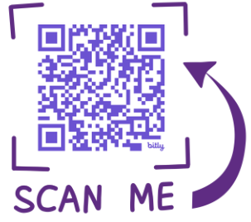
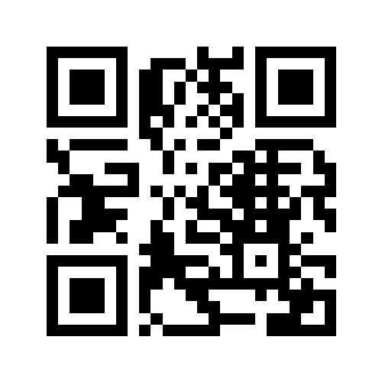




Help Me Get Better at Helping You!
We’d love your feedback.
Take a 2 minutes to complete this short feedback form and receive a Free Leadership
tool as a thank-you:
Thank you
Scan me
Every response is read. Every insight counts.
www.elvicore.com
1-281-858-3046
brucehuntley@elvicore.com

Slide 12


