Slide 1
From Service to Success: Building a Veteran-Ready Organization
Joe Punaro, Zeljana Manojlovic, Heather Kuzma
December 10, 2025

Slide 2
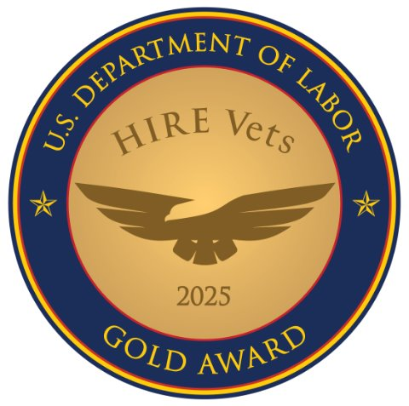
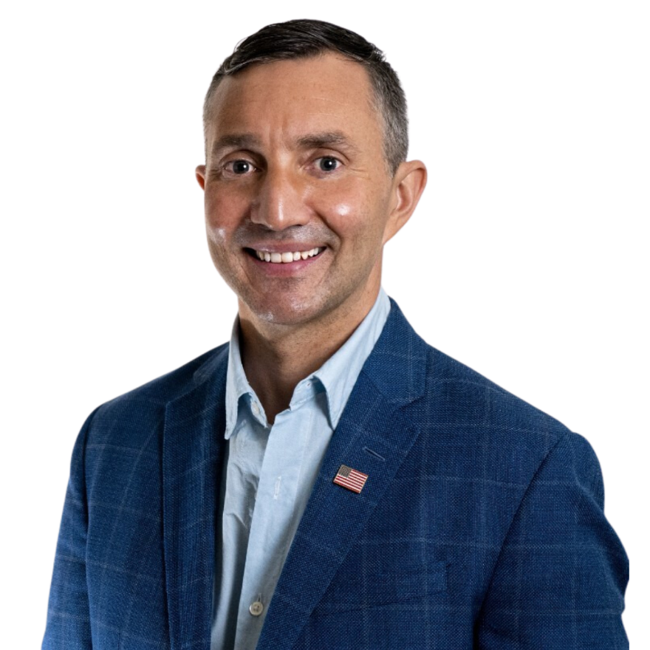

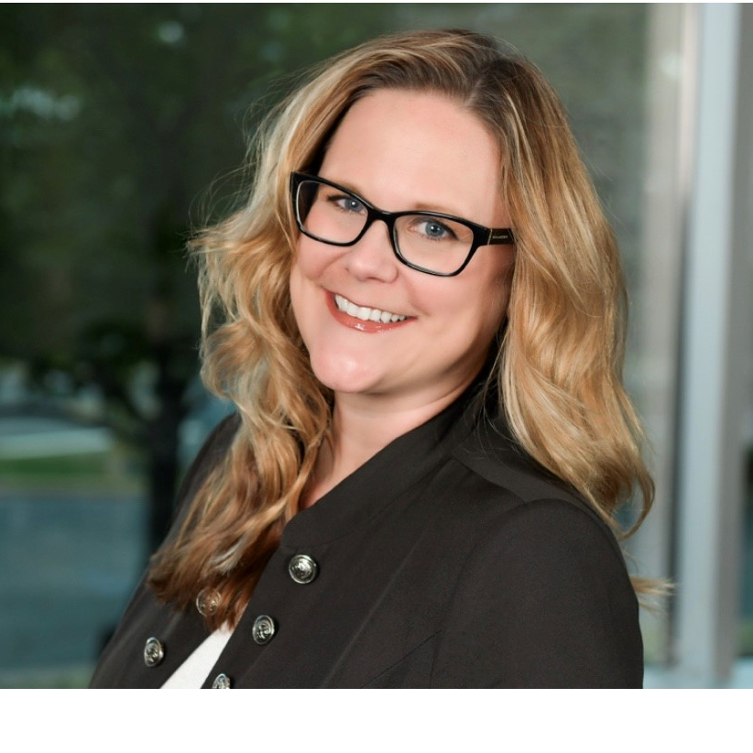
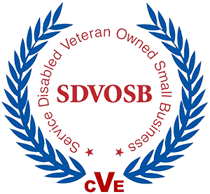
Introduction Hi, We're IronArch Technology
Joe punaro
Zeljana manojlovic
Heather kuzma
Joe Punaro is the founder and CEO of IronArch, a leading provider of IT modernization services to the Federal Government. Prior to IronArch, Joe served on active duty in the
Marine Corps.
Zeljana Manojlovic leads Employee Experience & Culture at IronArch. A SHRM-SCP with nine years of HR experience, she focuses on people-first, collaborative strategies that strengthen organizational culture.
With nearly a decade of recruiting experience, Heather Kuzma leads talent acquisition at IronArch Technology—driving strategic, inclusive hiring and leveraging her Military Veteran Recruiting certification to build strong, future-ready teams.
Notes:
Introductions
Joe
Thank you to Veteran Ready Summit and American Trucking Association
Joe Intro/Title
Brief overview of IronArch as a Service-Disabled Veteran-Owned Small Business (SDVOSB).
Highlight that 35%+ of the workforce are Veterans and why this matters for credibility. Our feedback from government is frequently rated excellent, particularly when Veterans are on the team. They crush it.
Pass to Z
Z
Heather

Slide 3
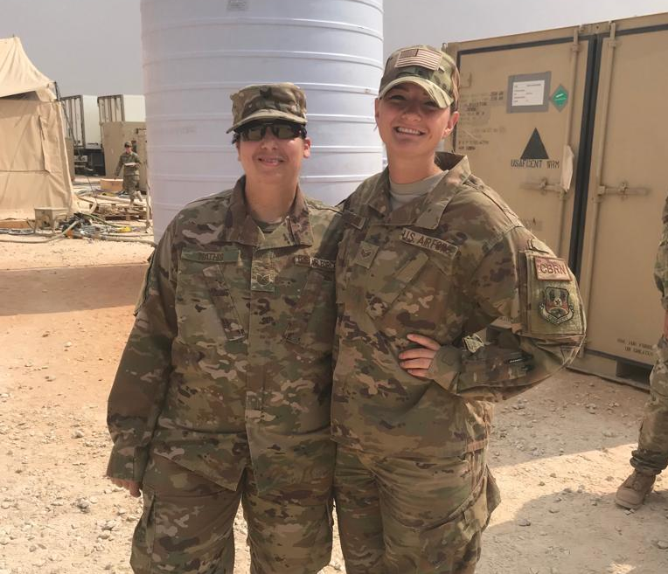
Introduction The Veteran Transition
Welcoming Veterans vs building the systems that help them thrive
Veterans shouldn't have to translate where they fit in
Purpose, trust, clear communication will resonate
Practices that scale and unlock a motivated, talented talent pool that strengthens the entire culture
Notes:
Audience Engagement: Who is a veteran and who employs veterans?
My journey as a veteran
JMU to USMC to Iraq
Why I got into industry
When I left the military had a misstep, which is perfectly ok
Selected the medical device industry
Felt pressure to take job
Missed the purpose I felt in the military
Missed the teamwork and camaraderie
The transition is hard and far from perfect
Read email from employee
The transition is hard, which is why we want to help set you and the veteran up for success
What veterans need when they transition
Daniel Pink - Purpose, autonomy, mastery
Need to have the structure in place to be Veteran Ready
IronArch VERG
3

Slide 4
Values & Leadership Aligning Values with Military Culture
Mission-First Mindset
Integrity & Accountability
Team over Self
Servant Leadership
Notes:
Values that mattered in the military translate to corporate America
Mission First Mindset
Doing whatever it takes to take the objective
We’ve built IronArch so everyone understands the purpose behind their work.
Explaining the “why” helps us to accomplish the mission
Integrity & Accountability
Do what you say you’re going to do; follow-up and follow-through
When a customer trusts us with a mission, we own the outcome.
The veterans will take care of customer but we need to make sure we are accountable to them
Team Over Self
Veterans think in terms of the unit, not the individual.
Everyone is a spoke in the wheel - Everyone has a role, and every role matters.
That mindset is a big part of why our teams perform so well.
Servant Leadership
At the end of the day, we exist to serve—our clients, our teammates, our communities, and the mission.
Important for company leaders to model this behavior to our veterans

Slide 5
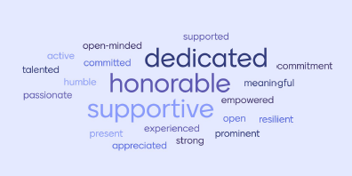
Values & Leadership Leadership That Veterans Trust
Ductus Exemplo (Lead by Example)
Direct Communication
Transparency in Decision-Making
Adaptability in Dynamic Environments
Notes:
Leadership principles that resonates with Veterans
Ductus Exemplo
Marine Corps Leadership Principle – Leady by example
Veterans expect leaders to model humility, service, and accountability.
Direct Communication
Feedback is a gift
Clear is kind, unclear is unkind
Veterans respond to leaders who communicate directly
This is similar to FITREPs in the military – no one can get better without coaching
Transparency
Employment expectations are clear.
Left and right lateral limits clearly articulated
Explain the why behind decisions.
Adaptability
You rarely get perfect information in the military.
Adapt and overcome
You learn to make informed decisions and move forward. Or make a mistake, correct it, and move on.
Turn over to Heather

Slide 6

The Veteran Experience: In Their Words
Here’s what Veterans must translate on paper.
Here’s what that process actually feels like for them.
Here’s how we (IronArch) proactively support them.
Here’s an example of impact (case study).
Notes:
Heather

Slide 7
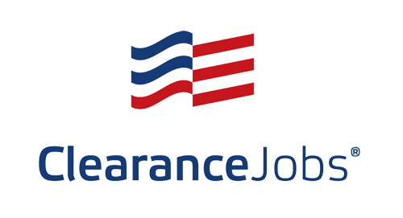
Veteran-Centered Recruiting Practices Outreach & Partnerships
Targeted Job Boards & Channels
Use of cleared job boards
Veteran-focused job boards
Employee referrals
Veteran Service Organizations (VSOs)
Partnerships with local & national VSOs for talent pipelines
Resource-sharing with organizations supporting employment readiness
Participation in Veteran-focused hiring fairs and webinars
Notes:
Heather
(3 mins)
This is where Heather's certification and experience shine.
Content:
Outreach strategies: TAP, VSOs, Guard/Reserve networks, job boards, employee referrals

Slide 8
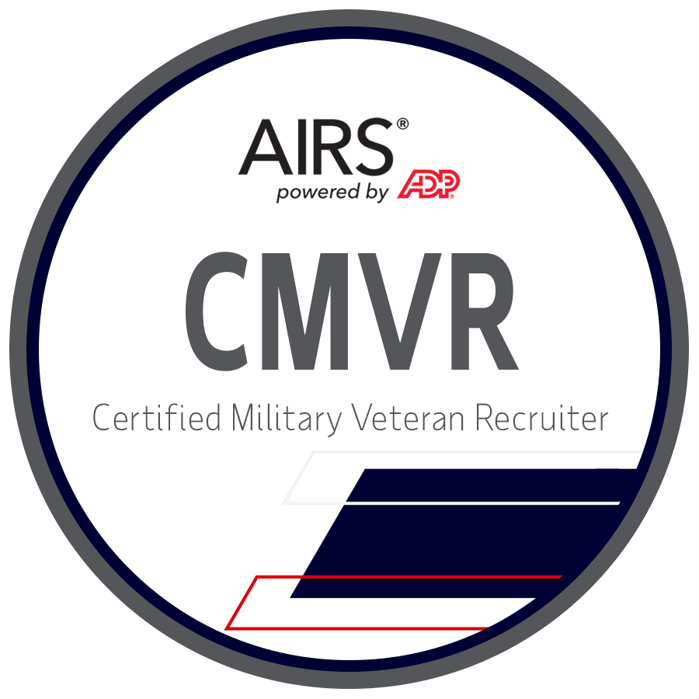
Veteran-Centered Recruiting Practices Certified Veteran Recruiter Role
Advocate for Veterans, connecting talent to opportunity
Translate military skills into civilian success
Guide top candidates to mission-critical roles
Support a Veteran-owned business with pride
Passionate about helping Veterans thrive
Notes:
Heather
(3 mins)
This is where Heather's certification and experience shine.
Content:
What a Certified Military Veteran Recruiter brings to the process

Slide 9

Supporting Military to Civilian Career Transitions Translating Military Skills
Pull out core strengths: leadership, teamwork, discipline
Map MOS/ratings directly to civilian roles and skills
Replace military terms with clear, business-friendly language
Highlight mission execution as project/operations experience
Showcase technical abilities in relatable industry tools/processes
Emphasize adaptability and real-world impact
Notes:
Heather
(3 mins)
Resume translation, hiring pathways, and candidate coaching are the recruiter’s core expertise.
Content:
Understanding transferable skills from military service
Translating MOS/ratings into business language

Slide 10
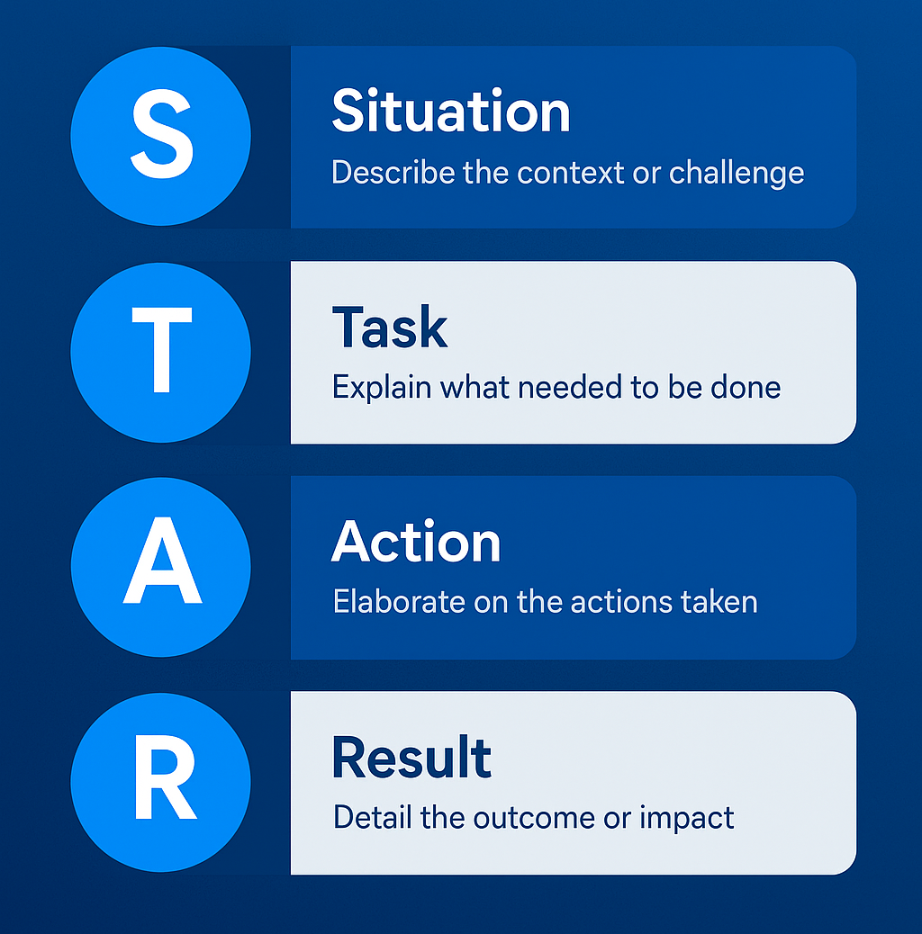
Supporting Military to Civilian Career Transitions Civilian-Ready Resume Tips
Keep it simple, clear, and business-focused
Lead with skills, not rank or paygrade
Translate acronyms and military terminology
Use accomplishment-focused bullets (STAR format)
Include certifications, systems, tools, and measurable impact
Tailor your resume to the role—one size doesn’t fit all
Notes:
Heather
(3 mins)
Resume translation, hiring pathways, and candidate coaching are the recruiter’s core expertise.
Content:
How she guides candidates through resume & interview support

Slide 11
Supporting Military to Civilian Career Transitions Career Pathway Mapping
Logistics
Supply Chain
Simple MOS-to-role crosswalks
Highlight transferable strengths
Quick guidance for hiring managers
Communications
IT Support
Squad Leader
Supervisor
Notes:
Heather
(2 mins)
Resume translation, hiring pathways, and candidate coaching are the recruiter’s core expertise.
Content:
Ensuring hiring managers understand military experience
Examples of Veterans placed successfully into roles
• Successful Veteran Placements • Logistics → Supply Chain • Communications → IT Support • Squad Leader → Supervisor

Slide 12
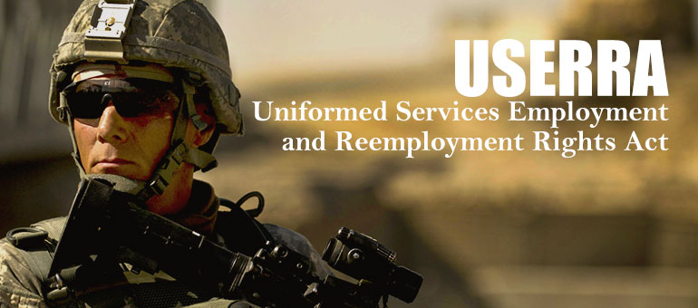
Veteran-Tailored Benefits That Drive Retention Paid Military Leave
USERRA protects jobs and seniority but does not require paid military leave.
IronArch goes further by offering Paid Military Leave, reducing financial strain during training or deployments.
Our generous PTO gives veterans and reservists added flexibility for appointments, transitions, and personal needs.
Notes:
Transition:
Thank you Heather – so amazing to hear how thoughtfully you’re able to humanize the veteran recruiting and hiring processes.
Veteran-Ready Organization: My Role & Philosophy
As I mentioned before, I lead IronArch’s Employee Experience & Culture (EEC) team.
My responsibility in being “veteran-ready” spans the entire employee lifecycle — from recruitment through long-term retention.
It’s not just about attracting incredible veteran talent; it’s about creating an environment where veterans want to stay because they feel supported, valued, and invested in.
Many of our benefits help all employees — but being veteran-ready means intentionally designing and evolving programs with our current and future veteran population in mind.
Paid Military Leave & USERRA Awareness
First, every employer should understand USERRA (Uniformed Services Employment and Reemployment Rights Act).
It guarantees job protection and seniority rights for those serving in the Guard, Reserve, or other active-duty capacities.
Compliance is the starting point — not the finish line — for a veteran-ready organization.
IronArch goes beyond the legal minimum by offering paid military leave:
This is separate from regular PTO.
It ensures employees can meet training, deployment, or duty-related requirements without financial stress.
This demonstrates that we aren’t just compliant — we’re committed.
Generous Paid Time Off
Again, this benefits all employees, but is especially important for veterans transitioning to civilian life.
PTO gives flexibility for:
VA appointments
Health needs
Relocation or transition logistics
Personal time as they adjust to life post-service
The peace of mind that this time is paid is critical during transition periods.

Slide 13




Veteran-Tailored Benefits That Drive Retention On-the-Job Support
Flexible Remote/Hybrid Schedules
Workplace Accommodations
Short-Term and Long-Term Disability
Virtual Healthcare Concierge
Notes:
On-the-Job Support & Flexible Work
Transitioning from military to civilian culture can feel like entering a completely new world.
On-the-job support helps veterans not just in their first 90 days, but continuously as they adapt and grow.
When possible, remote and hybrid flexibility makes a significant difference:
Allows for medical appointments, service-related commitments, and family responsibilities.
Supports military spouses as well.
Example: an employee whose spouse received new orders was able to remain with IronArch thanks to our remote-friendly environment.
Workplace Accommodations
Some veterans may come with service-connected disabilities.
Disabilities do not limit someone’s ability to be an exceptional performer.
What matters is having a thoughtful and thorough interactive accommodation process, and designing jobs that allow people to thrive.
Being veteran-ready means being proactive, not reactive, in considering accessibility and accommodations.
Short- and Long-Term Disability Coverage
Income replacement benefits are available to all employees.
These are particularly impactful for veterans managing chronic conditions or service-related injuries.
Having these protections ensures veterans don’t face financial hardship if they need medically required time away.
Virtual Healthcare Concierge Services
This benefit is far more valuable than people might initially think.
The transition from TRICARE to civilian healthcare is confusing — even for HR professionals.
Our concierge service helps by:
Explaining plan details in accessible language
Helping employees compare plan options
Researching providers
Scheduling appointments
Finding best pricing for procedures
This eases one of the biggest post-military stressors: navigating healthcare for the first time.

Slide 14
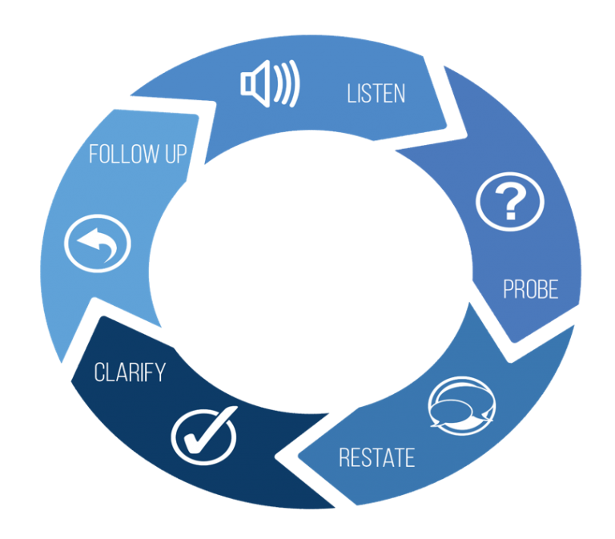
Veteran-Tailored Benefits That Drive Retention Wellness & Veteran-Ready Programs
Veteran Community & Mentoring: Veteran Employee Resource Group provides connection, shared experience, and support.
Wellness Reimbursement: Helps maintain physical and mental well-being.
Employee Assistance Program: 24/7 confidential mental health and family support.
Feedback-Driven Design: Programs shaped by veteran input to strengthen morale and retention.
Notes:
Veteran Employee Resource Group (ERG)
One of our most exciting new initiatives.
A dedicated community for:
Veterans
Military family members
Allies
Provides connection, shared experience, peer support, and a space where people feel understood.
Wellness Reimbursement
Veterans often leave an environment where fitness resources were freely available.
Suddenly, gym memberships, classes, and races are expensive.
We reimburse for:
Gym memberships
Virtual fitness subscriptions
Race/registration fees (5Ks, marathons, etc.)
This supports both physical and mental wellness during a major life transition.
Employee Assistance Program (EAP)
24/7 confidential counseling — free to employees.
Mental health support is essential for veterans and families.
Our EAP provides therapy, crisis support, and family resources anytime they’re needed.
Feedback-Driven Program Design
The most important element of being veteran-ready: listening to your people.
Ask veterans what they need, what’s working, and what gaps still exist.
Then — crucially — act on that feedback.
At IronArch:
We ask for feedback at quarterly All-Staff meetings.
We communicate what we heard and what actions we’re taking.
We acknowledge what we can’t implement yet, and why.
A strong feedback culture creates trust — especially within communities like our veterans, where trust is foundational.

Slide 15
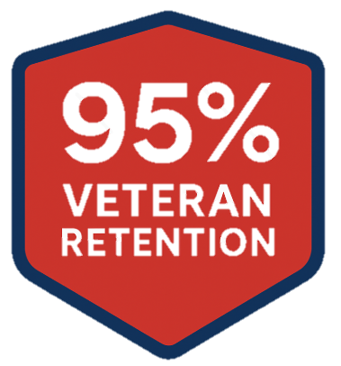
Belonging, Trust, and Real Results
Shared purpose from day one
Culture that feels familiar (shared purpose + structure)
Everyone has a valued role
Notes:
Veterans often describe the transition into civilian work as feeling like starting over — wondering if their skills translate or if they’ll fit. That’s why we put so much intentionality into building belonging from day one.
Shared purpose creates immediate connection. Structure creates familiarity during a time of uncertainty. And our team-first culture reinforces that every veteran has a meaningful, valued role here.
And when belonging is real — not just talked about — it shows up in outcomes. This year, we’re proud to have a 95% veteran retention rate, a direct reflection of trust, support, and a culture where veterans choose to stay and thrive.

Slide 16
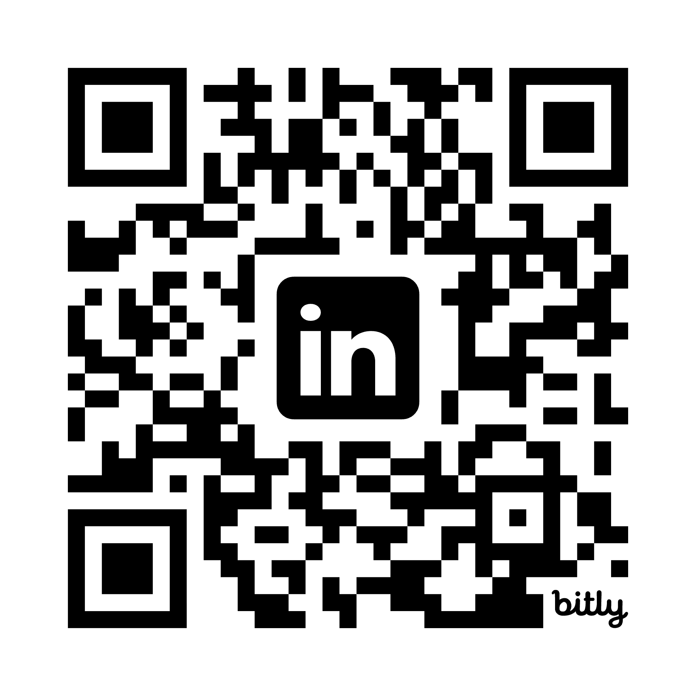
Resources for You
Follow us on LinkedIn – resources drop today!
Strategies to become a Veteran-ready organization
Veteran-ready leadership checklist
Veteran-ready self-evaluation
Notes:
If you’re ready to be Veteran-Ready – we’ve got some resources for you!
Scan the QR code to follow us on LinkedIn where we’ll share materials that you can use to implement the strategies we’ve discussed today.

Slide 17
Strategies to Become a Veteran-Ready Organization
Sneak peek!
1. Align Your Culture with Military-Informed Values
Define and communicate a clear mission so employees understand the “why.”
Reinforce accountability as a trust-building behavior, not a punitive one.
Create a team-first environment where every role is respected.
2. Build Leadership Practices Veterans Recognize and Trust
Expect leaders to model behavior (“Ductus Exemplo”)—service, humility, and ownership.
Promote direct, timely communication and transparent decision-making.
Train supervisors to recognize military skill sets and support transition challenges.
3. Implement Veteran-Tailored Benefits & Support Systems
Offer paid military leave for reservists and Guard members.
Provide flexible remote/hybrid options, especially for disabled or transitioning Veterans.
Establish ongoing mentorship or buddy programs that pair Veterans with other Veterans.
4. Strengthen Recruiting Practices to Remove Barriers
Use targeted job boards and partner with VSOs and TAP programs.
Train recruiters and hiring managers to translate MOS/AFSC ratings into civilian skills.
Communicate clearly with Veteran applicants—no guesswork, no silence.
5. Support the Military-to-Civilian Career Transition
Use resume translation tools and simple MOS-to-role crosswalks.
Lead with skills and impact, not rank.
Notes:
Here’s a sneak peak of what you’ll get and how you can take the cultural and operational elements we talked about today and translate them into practical, repeatable actions to take your organization from Veteran-Friendly to Veteran-Ready!

Slide 18
Veteran-Ready Leadership Checklist
Sneak peek!
Mission, Culture & Values
Our organization clearly communicates mission and purpose to all employees.
Leaders connect daily work to a higher purpose. We foster a “team over self” mindset where every role is valued.
We use structured, predictable processes that create clarity and reduce ambiguity.
Leadership Behaviors
Leaders demonstrate Ductus Exemplo—servant leadership through action.
Communication is direct, timely, and respectful. Decisions are transparent, and context is shared when possible.
Teams are encouraged to act with adaptability rather than wait for perfect information.
Trust & Belonging
Veterans feel a sense of shared purpose from day one.
Our environment feels familiar—structure, clarity, and accountability are norms.
We acknowledge the emotional challenge of transitioning to civilian work.
We have systems that help Veterans find their place and feel valued.
Recruiting & Hiring
We have at least one Veteran-trained or certified recruiter.
Applicants receive clear communication throughout the hiring process.
MOS/AFSC experience is actively translated—not overlooked.
We seek partnerships with VSOs, TAP offices, and Veteran-focused networks.
Benefits & Employee Support
We offer paid military leave for Guard/Reserve members.
Flexible remote/hybrid options support medical, family, and post-service needs.
We have Veteran mentors or affinity groups to support belonging.
Wellness resources support physical, mental, and emotional readiness.
Notes:
Here’s a sneak peak of what you’ll get and how you can take the cultural and operational elements we talked about today and translate them into practical, repeatable actions to take your organization from Veteran-Friendly to Veteran-Ready!

Slide 19
Q & A
Notes:
(2-3)
And now we’ll open up the floor for any questions.

Slide 20
Thank you.
Visit us at ironarchtechnology.com
Notes:
20

