Slide 1
How the Semiconductor Industry is Coming Together to Expand Military Hiring Initiatives
Melinda Gomez
Manager of Military Initiatives, SEMI
Notes:
Mike G with WD will kick things off, announcing the launch of their Salute to Service initiative and will introduce MG

Slide 2




SEMI Foundation Holistic Workforce Development Plan
Narrowing the Talent Gap Requires: A Youth to Whole-Career Approach
Excite and inspire early … 3rd grade onward
Attract and motivate K12-college
Pathways to professional careers
Continuous learning
Re-Skilling
Returning
Workers &
Veterans
Career & Beyond
Primary School
High School
Community
College
University
Certifications
National Network for Microelectronics Education |  |  |  | Chips & Childcare |  |  |  | ChipPath Career Exploration Site
Mentoring Programs |  |  |  | SEMI Certifications |  |  |  | SEMI Vetworks
Workforce Intermediary |  |  |  | High Tech U |  |  |  | Roadtrip Nation Documentary
Semiconductor Career and Apprenticeship Network (SCAN) |  |  |  | Excellence in Achievement Award |  |  |  | K-12 Educator Resources/ Train the Trainer
Workforce Pavilions |  |  |  | Virtual Events & Trainings |  |  |  | Women in Semiconductors
Publications & Media |  |  |  | Industry Image and Awareness Campaigns |  |  |  | Women of Fab Owners Alliance
SEMI U e-Learning Platform |  |  |  | University Programs |  |  |  | Semiconductor Days
A Broad Range of Programs
300+ Companies Engaged in Programs
40 Million Potential Employees Impacted

Slide 3


















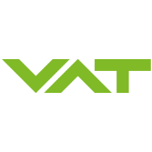





























































































Semiconductor Global Supply Chain
Electronics Systems $1.9T
Semiconductors $625B
Total Equipment $115B Assembly & Test Services $40B
Materials $68B & Sub-Components $18B
AI
Quantum Computing
Design
Automation $16B
Near-zero fatalities
Zero Emissions
Machine Learning
5G to 6G
Autonomous Vehicles
Electric Vehicles
Bitcoin Mining
Driver Assistance
Fleet
Blockchain
Digital Economy
Smart City
Trucking
Health Span to Life Span
Fitness Tracking
4th Industrial Revolution Industry 5.0
Realtime Configuration
Robotics
Smart Infrastructure
Biometrics
Human Performance Monitoring
Dosage Monitoring
3D Printing
Adaptive Manufacturing
AR/VR
CRISPR
Wearables
2022 Market Data Estimates Sources: SEMI, IC Insights and TechInsights
Notes:
SEMI is the Global Trade Association for Microelectronics - Design and Manufacturing. We have 2500 MEMBER COMPANIES.
Finding talent is their number 1 problem standing in the way of their growth and innovation, and that includes national and economic security. Our members have over 32,000 openings across the country.
Who are these companies?
This crazy diagram show all types of companies in the semiconductor industry grouped in rings and just some of our members. We’ve got material suppliers, software companies, designers, manufactures, and system integrators.
You probably know the companies in the outer ring: Apple, Tesla, Google, Amazon – they make the product you buy and use. You may not know the inner rings, like who makes software or chemicals the factories use.
But they are all important, and they are all experiencing workforce shortages.
We’ve got people today from fabs, equipment makers, and their subcomponent supplier – jobs everywhere.
As I said at the start: Our Member companies Need you!
Why are ex-military people great at semiconductor jobs? A lot of similarities. Both rely on sophisticated equipment. Military personnel are trained to use and operate expensive gear. They know how to maintain and repair the equipment, make sure everything is working properly – you have to do this with great care because lives depend on it. Now bring those same skills, mentality, attention to detail – all of it, to a fab. That training is equally effective in keeping a fab with all it’s sophisticated facilities and tools running smoothly. And when shit does go wrong, military people know how deal with unexpected problems and get things under control. It’s always been very comforting to know you’ve got a good crew on the job.

Slide 4
Why?
Big Disruptions: AI, 5G, Smart Manufacturing..
Geopolitical Shifts
Reshoring and Expanding US Operations
Retiring Generation
Diminished Interest in STEM
Unclear Pathways
Result: Expected 100,000+ Gap by 2030

Slide 5

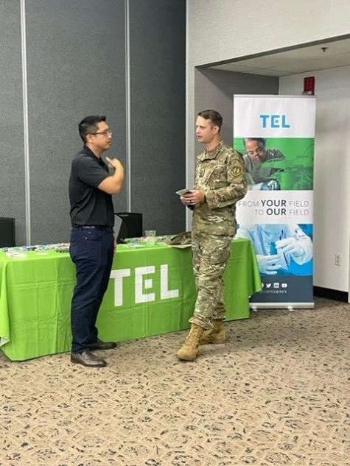
SEMI VetWorks
Strategic Partnerships
DOL VETs Employment Navigator Partnership Program (ENPP)
US Chamber of Commerce Foundation- Hiring Our Heroes
US Army Public Private Partnership (P3)
Manufacturing Institute- Heroes MAKE America
NY CREATES VetSTEP
Military Spouse Employment Partnership
Penn State Micro Nanotechnology Certificate Program (MNCP)
Military Hiring Events
SEMI-led with partners nationwide at military installations, on college campuses, and virtually
Notes:
SEMI Vetworks helps connect industry and members of military community. This is such an excellent career pathway work as veterans often have so many transferable knowledge, skills, abilities, and interest areas that align with the semiconductor industry. As you can see we have many strategic parterships that allow us to conduct this work

Slide 6
SEMI VetWorks
Engaging Military Community
Awareness Campaign
Video Story Telling of Veterans in Industry
Engaging Trusted Partners
Industry Approach
Employer Support
VetWorks Advisory Group
Employer Guide to Attracting, Hiring, and Retaining Military Talent
Consulting on Military Strategy
Highlighting Open Roles
Resume Sharing
Opportunities for Direct Engagement
Notes:
SEMI Vetworks helps connect industry and members of military community. This is such an excellent career pathway work as veterans often have so many transferable knowledge, skills, abilities, and interest areas that align with the semiconductor industry. As you can see we have many strategic parterships that allow us to conduct this work

Slide 7
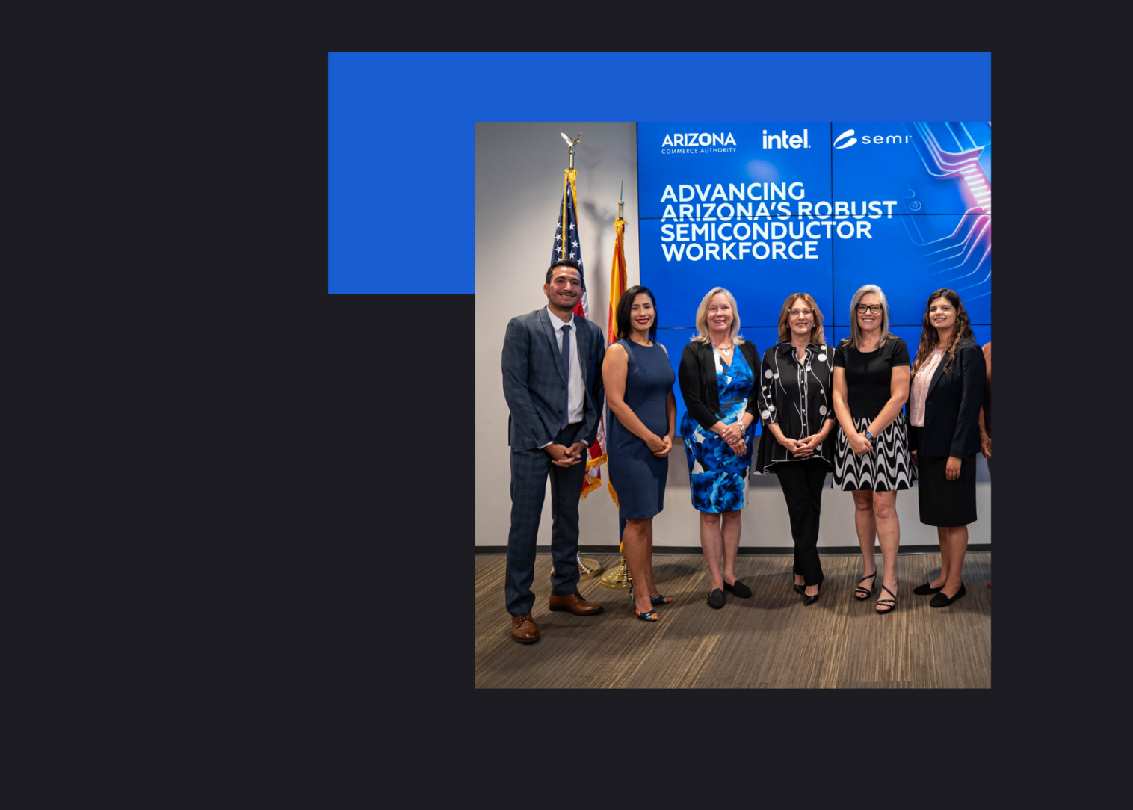
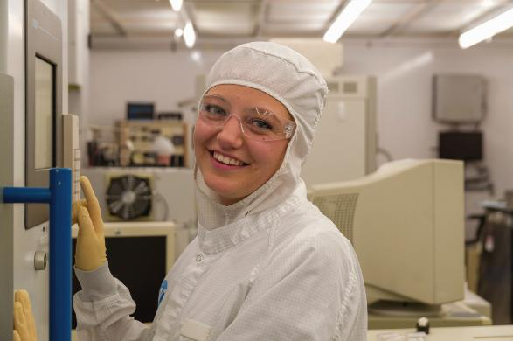
Training and
Registered Apprenticeships
Providing Pathways for Students and Jobseekers to Learn High-Demand Skills
Registered Apprenticeship Programs (RAP)
A proven model known for structure, rigor, and quality and for their ability to train workers with precise skill sets needed by employers.
RAPs build large talent pools, develop pipelines of supervisors, and significantly increase retention.
SEMI Foundation currently supporting RAPs with Intel, Applied Materials, Nokia, Western Digital, TSMC, Enablence, and more..
Certification Program
In Piloting to establish Industry-Recognized Certifications
Short and Longer Training Programs
Creating and scaling pre-, post-, and non-apprenticeship certificate and upskilling training programs
Notes:
RAP is relatively new to the industry as a whole, but it is an excellent means to home-grow your own workforce and ensure that your incoming team members have exactly the skills you need. We are a DoL RA Ambassador and we currently run RAPs in CA, AZ, and are building in MI and exploring in several other states. We also create custom shorter and longer training programs, based on member needs.

Slide 8

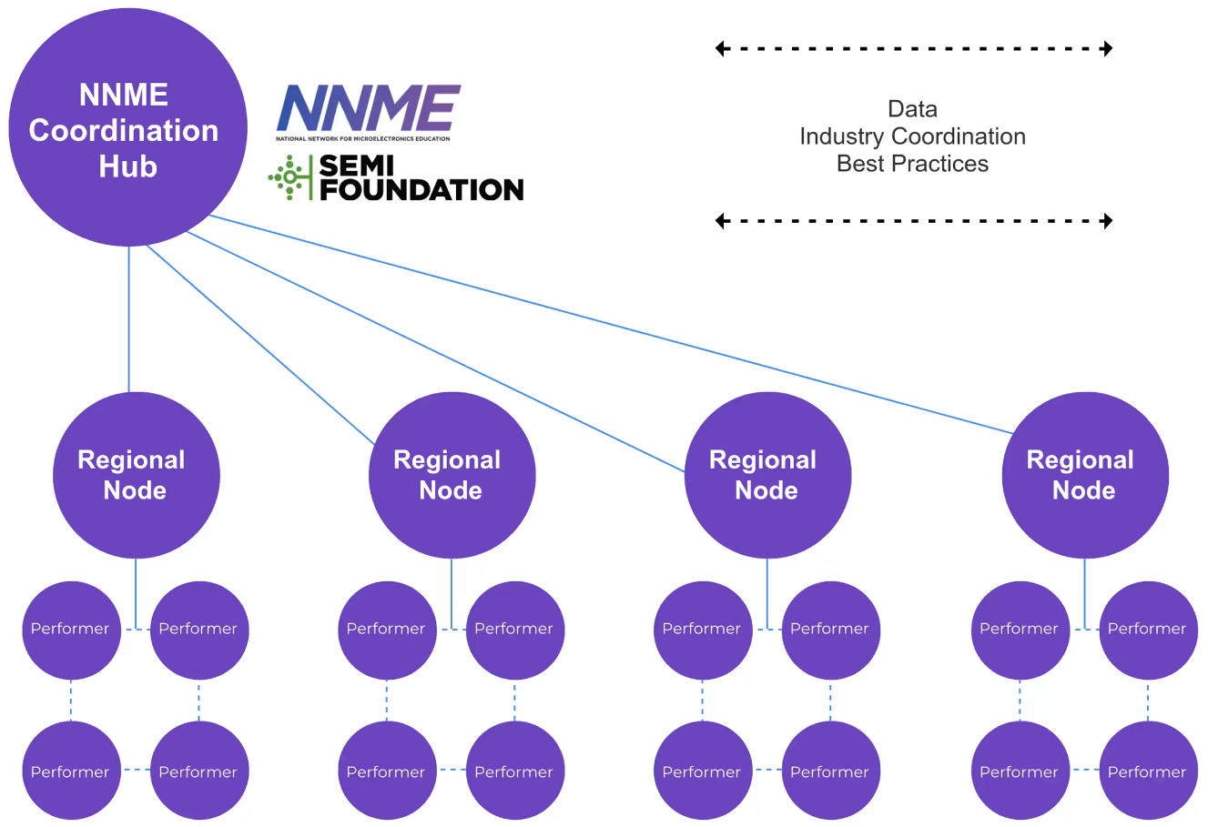
SEMI Foundation is the operator of the NNME - federally-funded structure for coordinating semiconductor education and workforce development
Post-secondary focus, building supply for industry workforce demand
RFP out for Regional Nodes
Areas of Focus:
Curriculum & Training
Industry Awareness
Network & Access
Notes:
NNME is a national push for a coordinated network funded by NSF & Commerce
It provides the structure for actualizing modernized and improved programs that help workers contribute to the industry’s growth
It is the right time to launch NNME, and as the operator, we are deep in building this and housing best practices and relationships

Slide 9
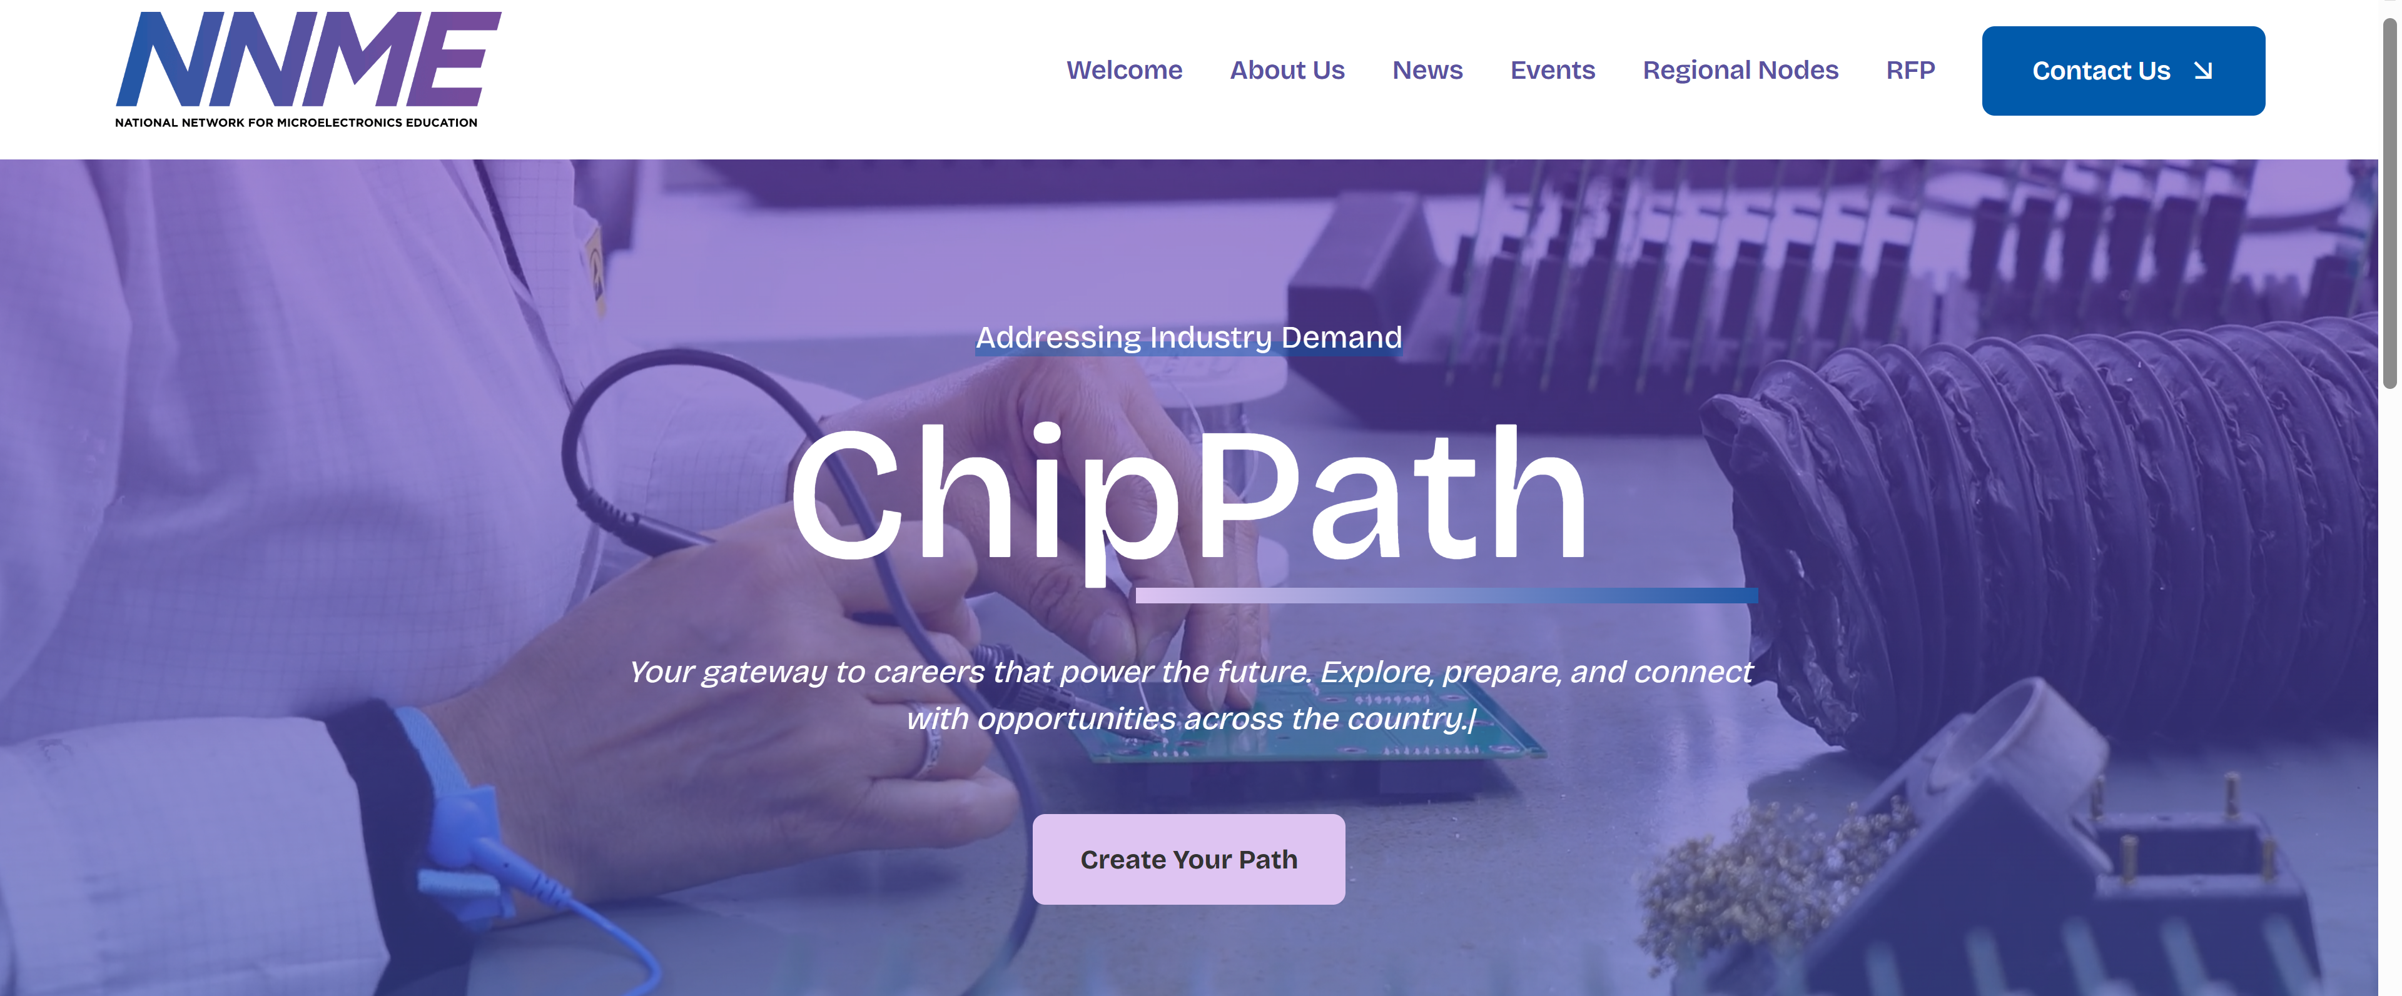
Notes:
On to our career portal, which I could talk about all day long. If you haven’t checked this out yet, believe me you will get lost in all of the incredible information available in it. There are sections for research, training programs even job search functions. My favorite though is the job match tool- especially the piece built in especially for veterans. They can go in and put their military occupation, take a skills and interest assessment and it will give recommendations on career pathways to consider. They can then see earnings potential, companies that seek these types of candidates and even run a job search connected to the national labor exchange! Definitely take some time to explore this site if you haven’t already!

Slide 10
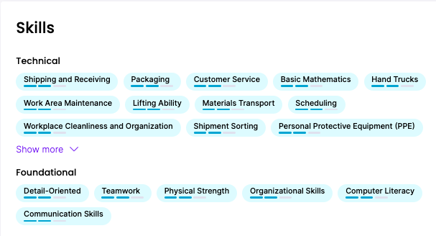
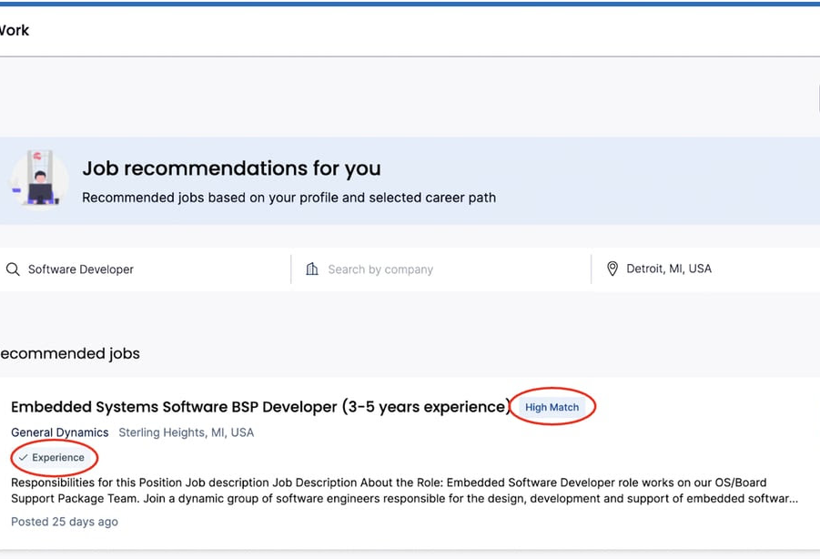



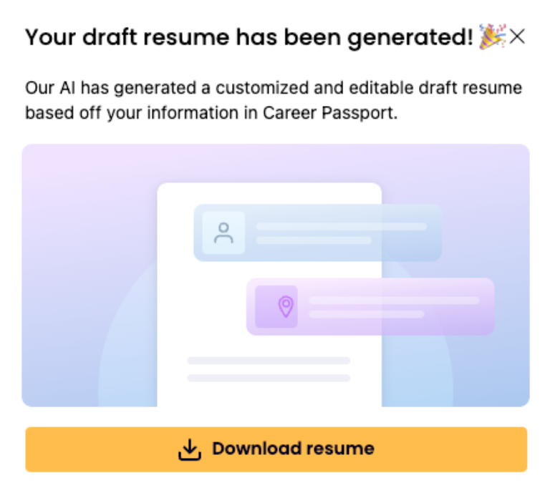





AI Skills Profiler
Auto-generates a skills profile based on a user’s past experience, tapping into a database of 30,000 skills
to fuel career guidance
AI Career & Job Recommenders
Provides a ranked list of top careers and live job postings that align to the user’s skills, experience, and interests, with a clear view of how their skills stack up
AI Features
AI Resume Generator
Employs Large Language Models (LLM) to help job seekers create up-to-date and professional resumes with just one click
AI Candidate Recommender
Streamlines the hiring process by providing best-fit candidates for open job postings, including “trainable” candidates with key transferable skills

Slide 11
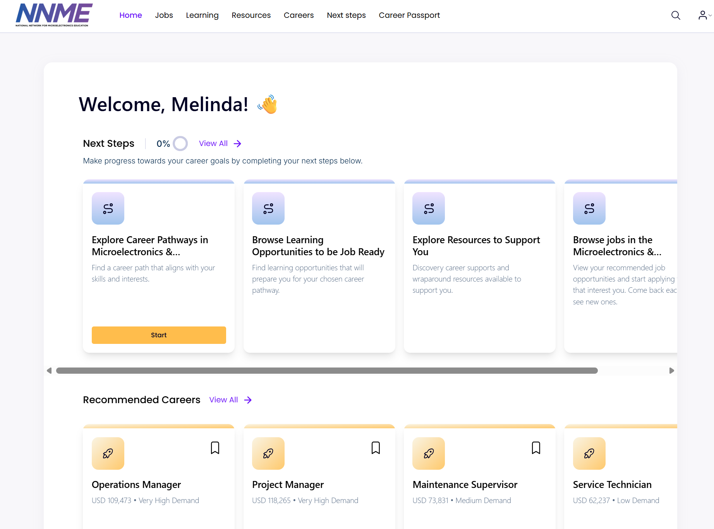
Career Exploration
110 career profiles
Education & Training
2500+ courses &
programs
Job Openings
90K+ live postings

