Slide 1
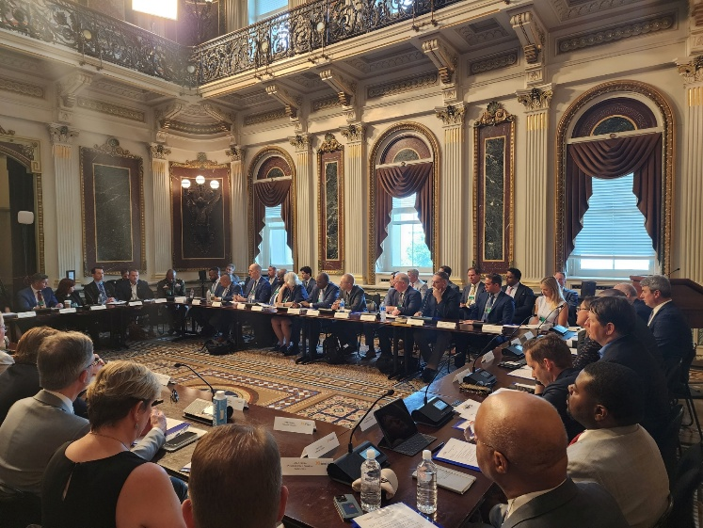
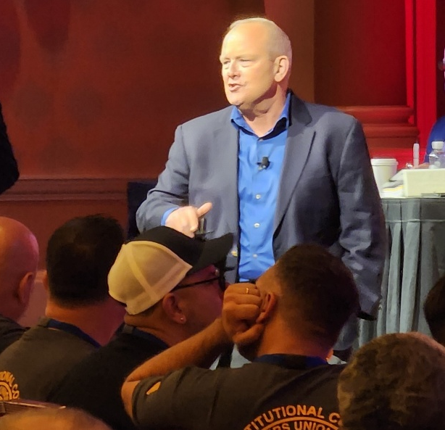

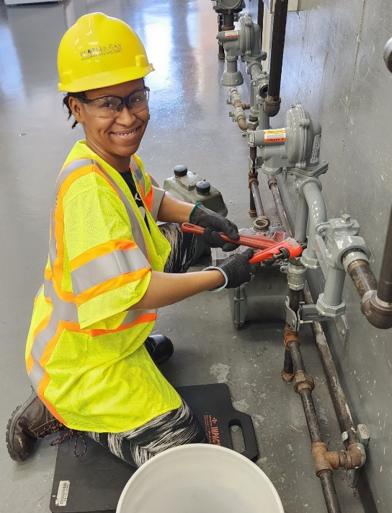
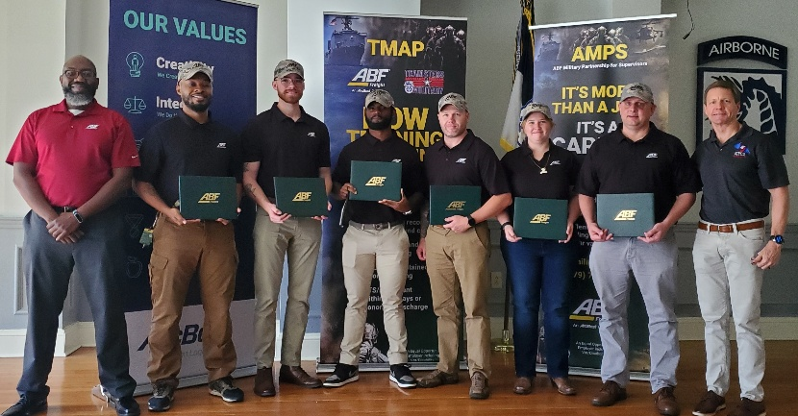
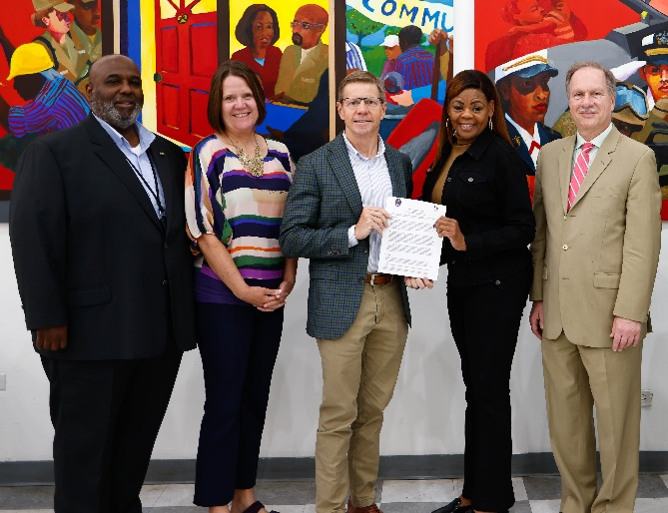
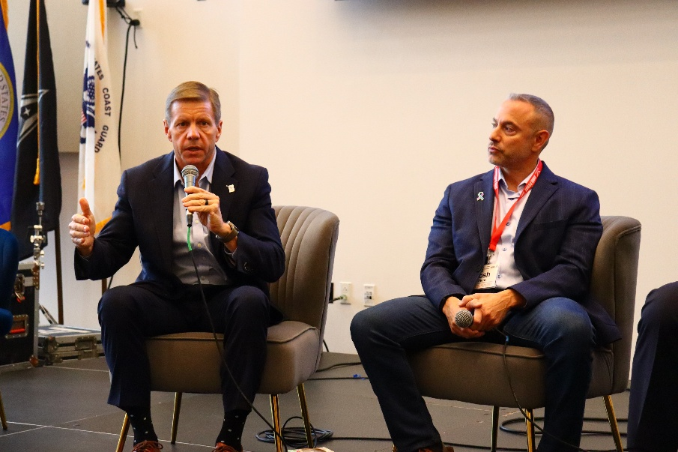

Slide 2
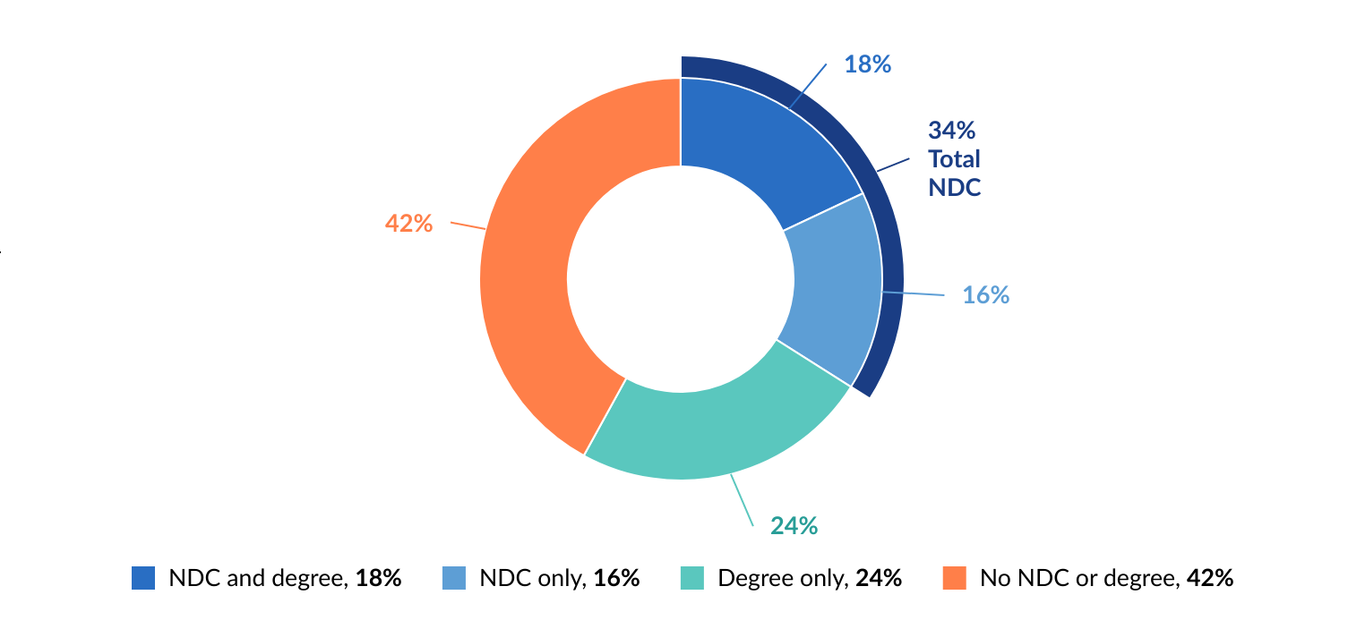
Over one in three adults have a nondegree credential

Slide 3
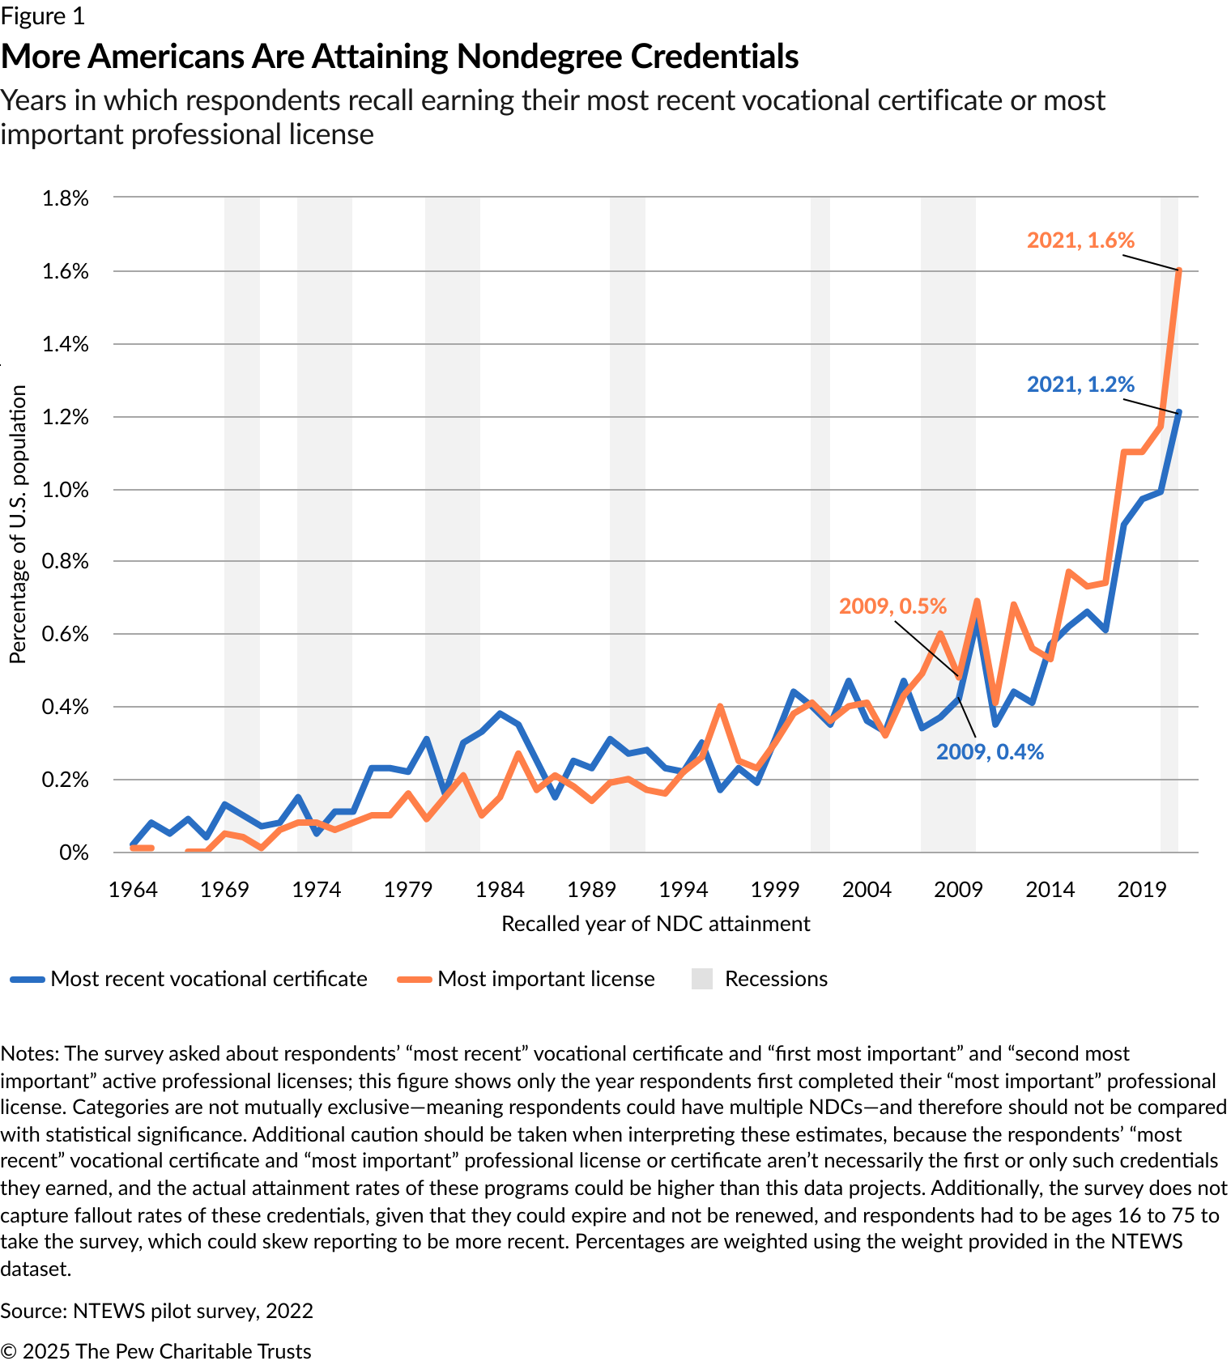
Growth in nondegree credential attainment

Slide 4
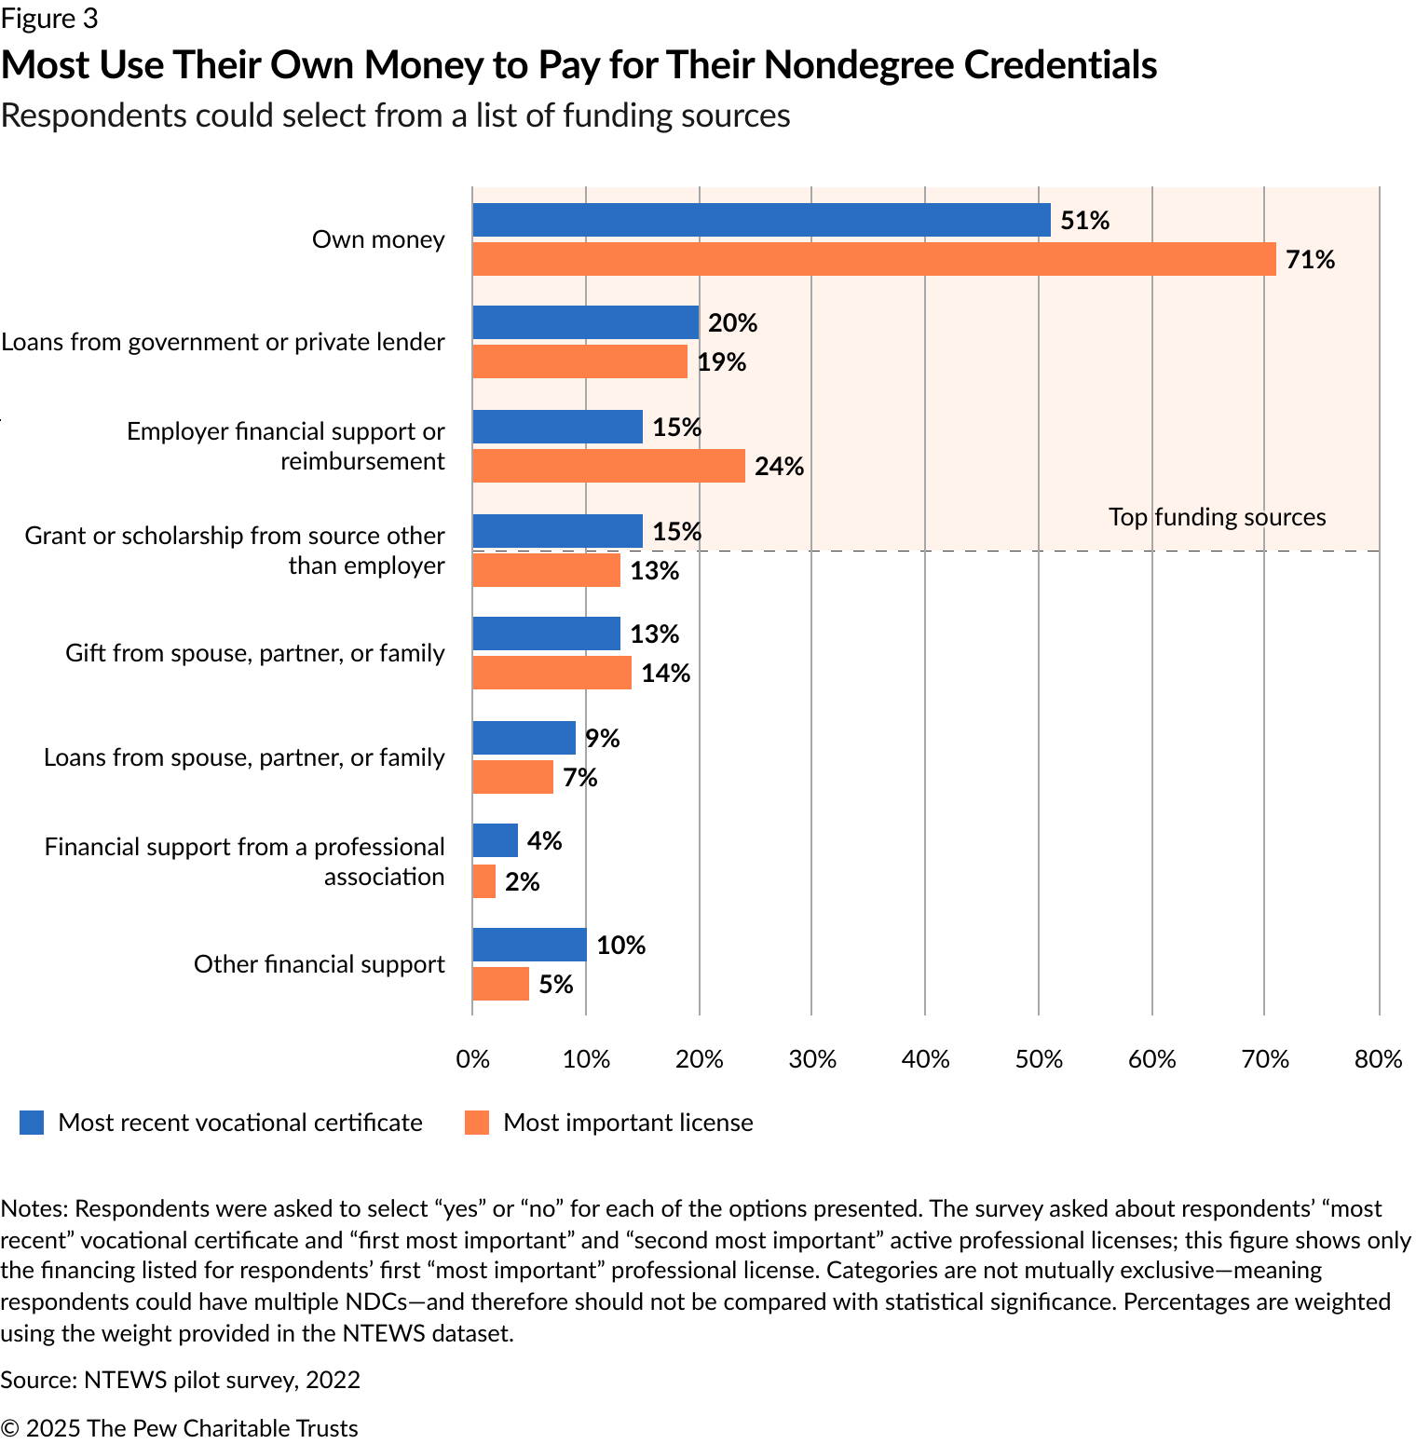
How people pay for nondegree credentials …

Slide 5
Dixon Center for Military and Veterans Services connects individuals, organizations, and community stakeholders to collaborate and contribute to the overall well-being of veterans and their families
Our mission is to increase the impact of organizations and programs that serve veterans and their families.
Heal with Honor: Creating solutions that focus on the overall wellness and well-being of veterans and their families. (Mental Health)
Live with Hope: Accessing affordable housing—living in a safe, secure, and comfortable environment in harmony with a local community. (Operation Veterans Empowerment)
Work with Purpose: Careers that allow veterans to support their family and to save for their future—competitive wages, healthcare, and benefits.
Focus today: Alternative pathways and micro-credentials translate real-world experience into fast, flexible career opportunities beyond the four-year degree. Examples include apprenticeships, industry certifications, community-college certificates, and on-the-job training programs.

Slide 6
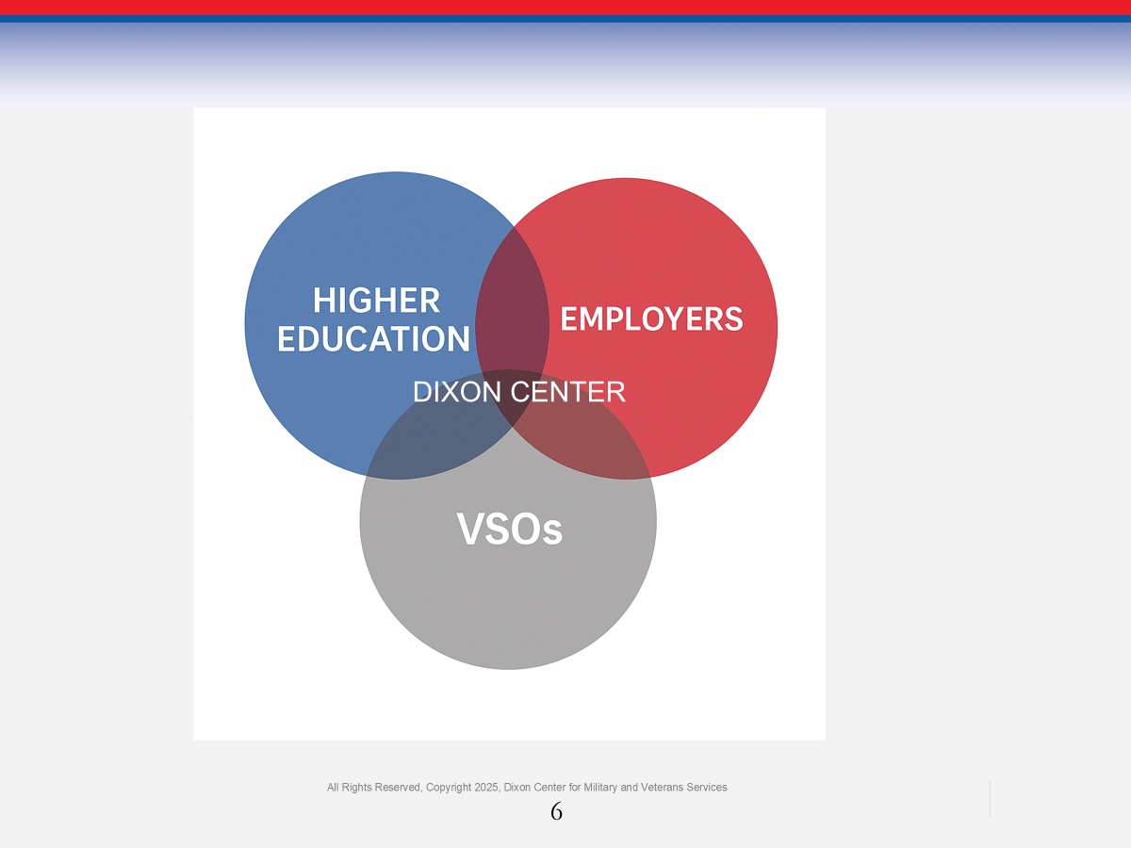
DIXON CeNTER Research collaborative - BUILDING CAPACITY FOR Opportunity
Who We Are
The Dixon Center Research Collaborative is a focused initiative that generates actionable, nimble research, training, and advocacy, serving as the nexus for colleges, employers, and service providers — removing barriers and creating sustainable support systems for veteran transition. The DCRC stands apart by closing system-level gaps—turning research into tools, practices, and policies that improve outcomes for veterans nationwide.
What We Do
Identify barriers and enablers in veterans’ education and career outcomes
Study alternative, non-traditional career and education pathways
Share findings to inform policy, practice, and program development
Our Impact
Guide institutions in creating veteran-inclusive practices and programs
Enhance the capacity of stakeholders to provide effective, scalable veteran support
Grow access and awareness of alternative pathways to military learners

Slide 7
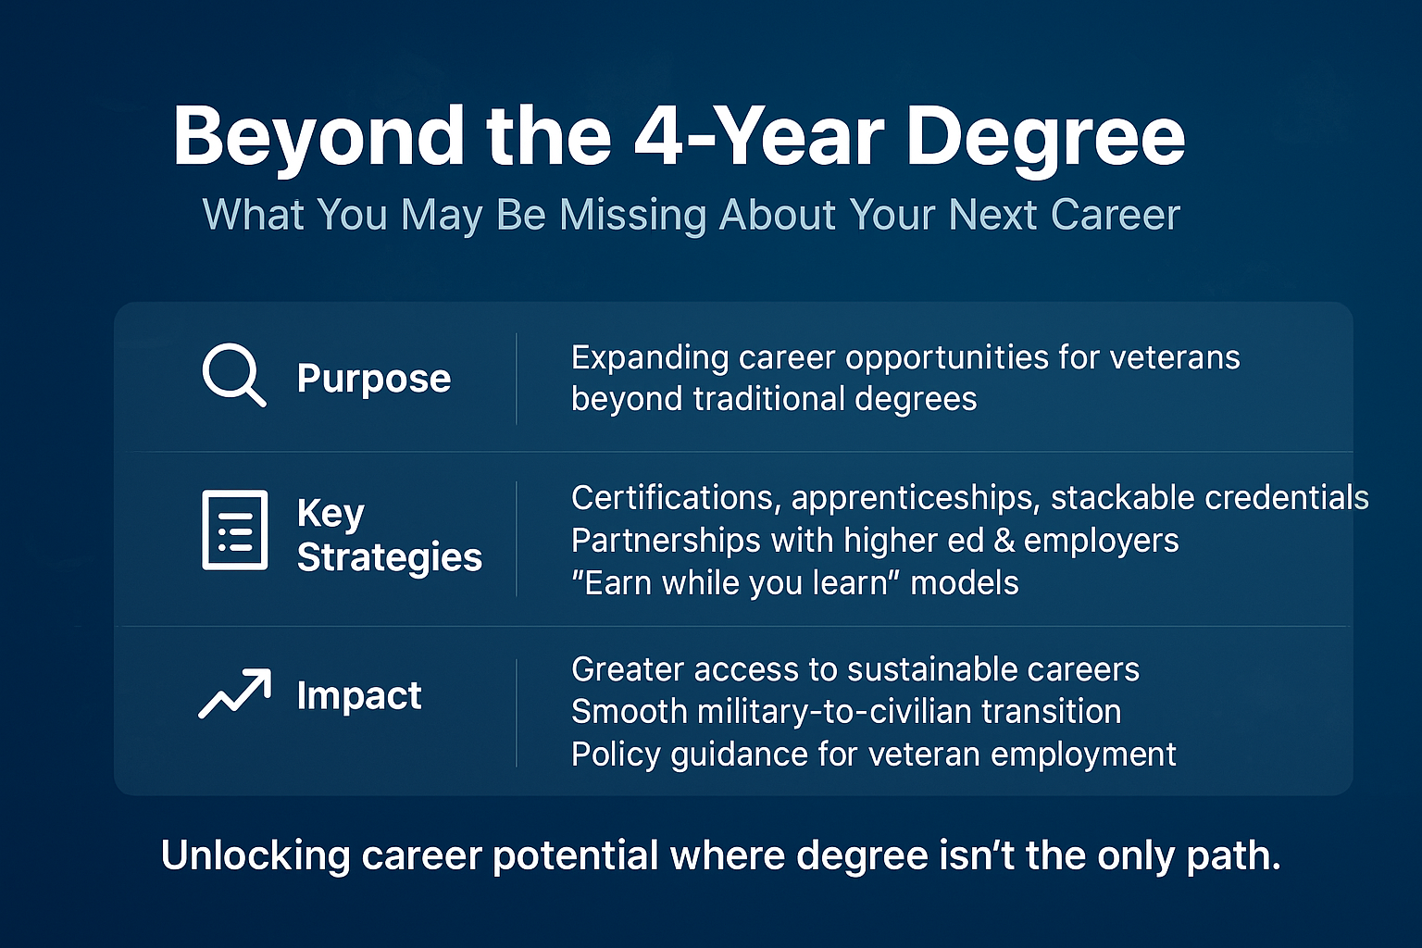
©

Slide 8
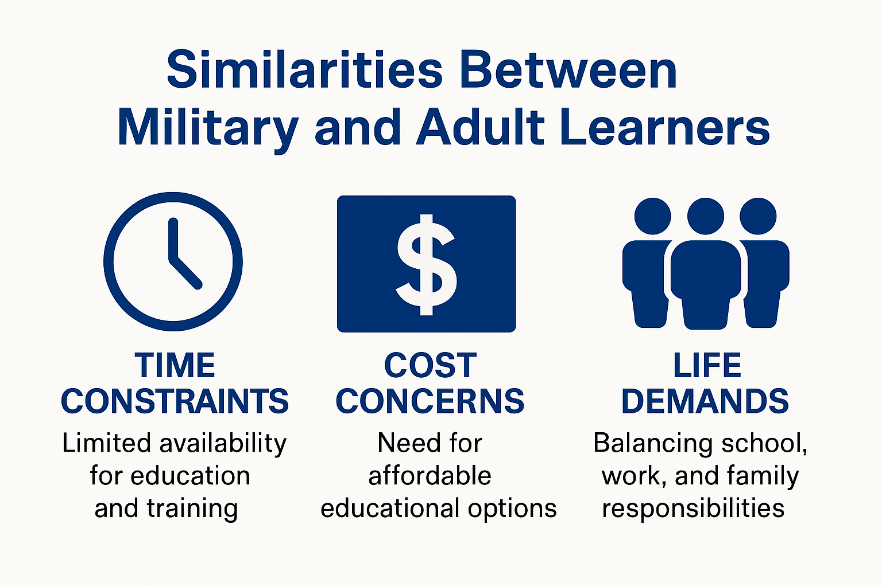
The Needs of Adult and Military Learners Driving Credential-Based Learning
A growing number of adults pursuing opportunities to reskill or upskill, according to some data, by double digits
In 2022-23, about 943,000 of those with “some college” re-enrolled - an increase of 78,300 (8%) from the previous year. (National Student Clearinghouse)
These learners lead the transfer student population at 52%. (National Student Clearinghouse)
Cost, flexibility, and relevance are big motivators- of U.S. adults had considered returning to school to 60% complete or start credentials, with finance being the largest concern (Business Wire)
Among adult learners, nearly 90% prefer hybrid or online-only courses, reflecting the need for flexibility (reupeducation.com) Retain COVID-era programming.

Slide 9
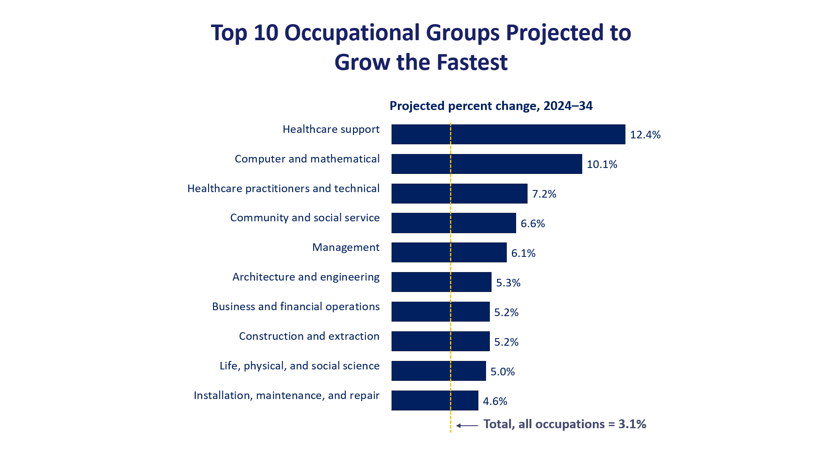
Industry Driving the Increase in Credential–Based Learning
According to the Coursera “Micro-Credentials Impact Report 2025,” 97% of employers globally are using or exploring skills-based hiring, and 96% agree micro-credentials strengthen a candidate’s application. Lumina Foundation+1
The same report says 87% of employers hired at least one candidate with a micro-credential in the past year — demonstrating that these credentials are not just theoretical but actively used in hiring.
Alternative pathways dramatically increase employment mobility and wage acceleration for adult learners.
A Deloitte report that 90% employers have better outcomes when they hire for skills, leading to a tripling in earn while you learn pathways.

Slide 10
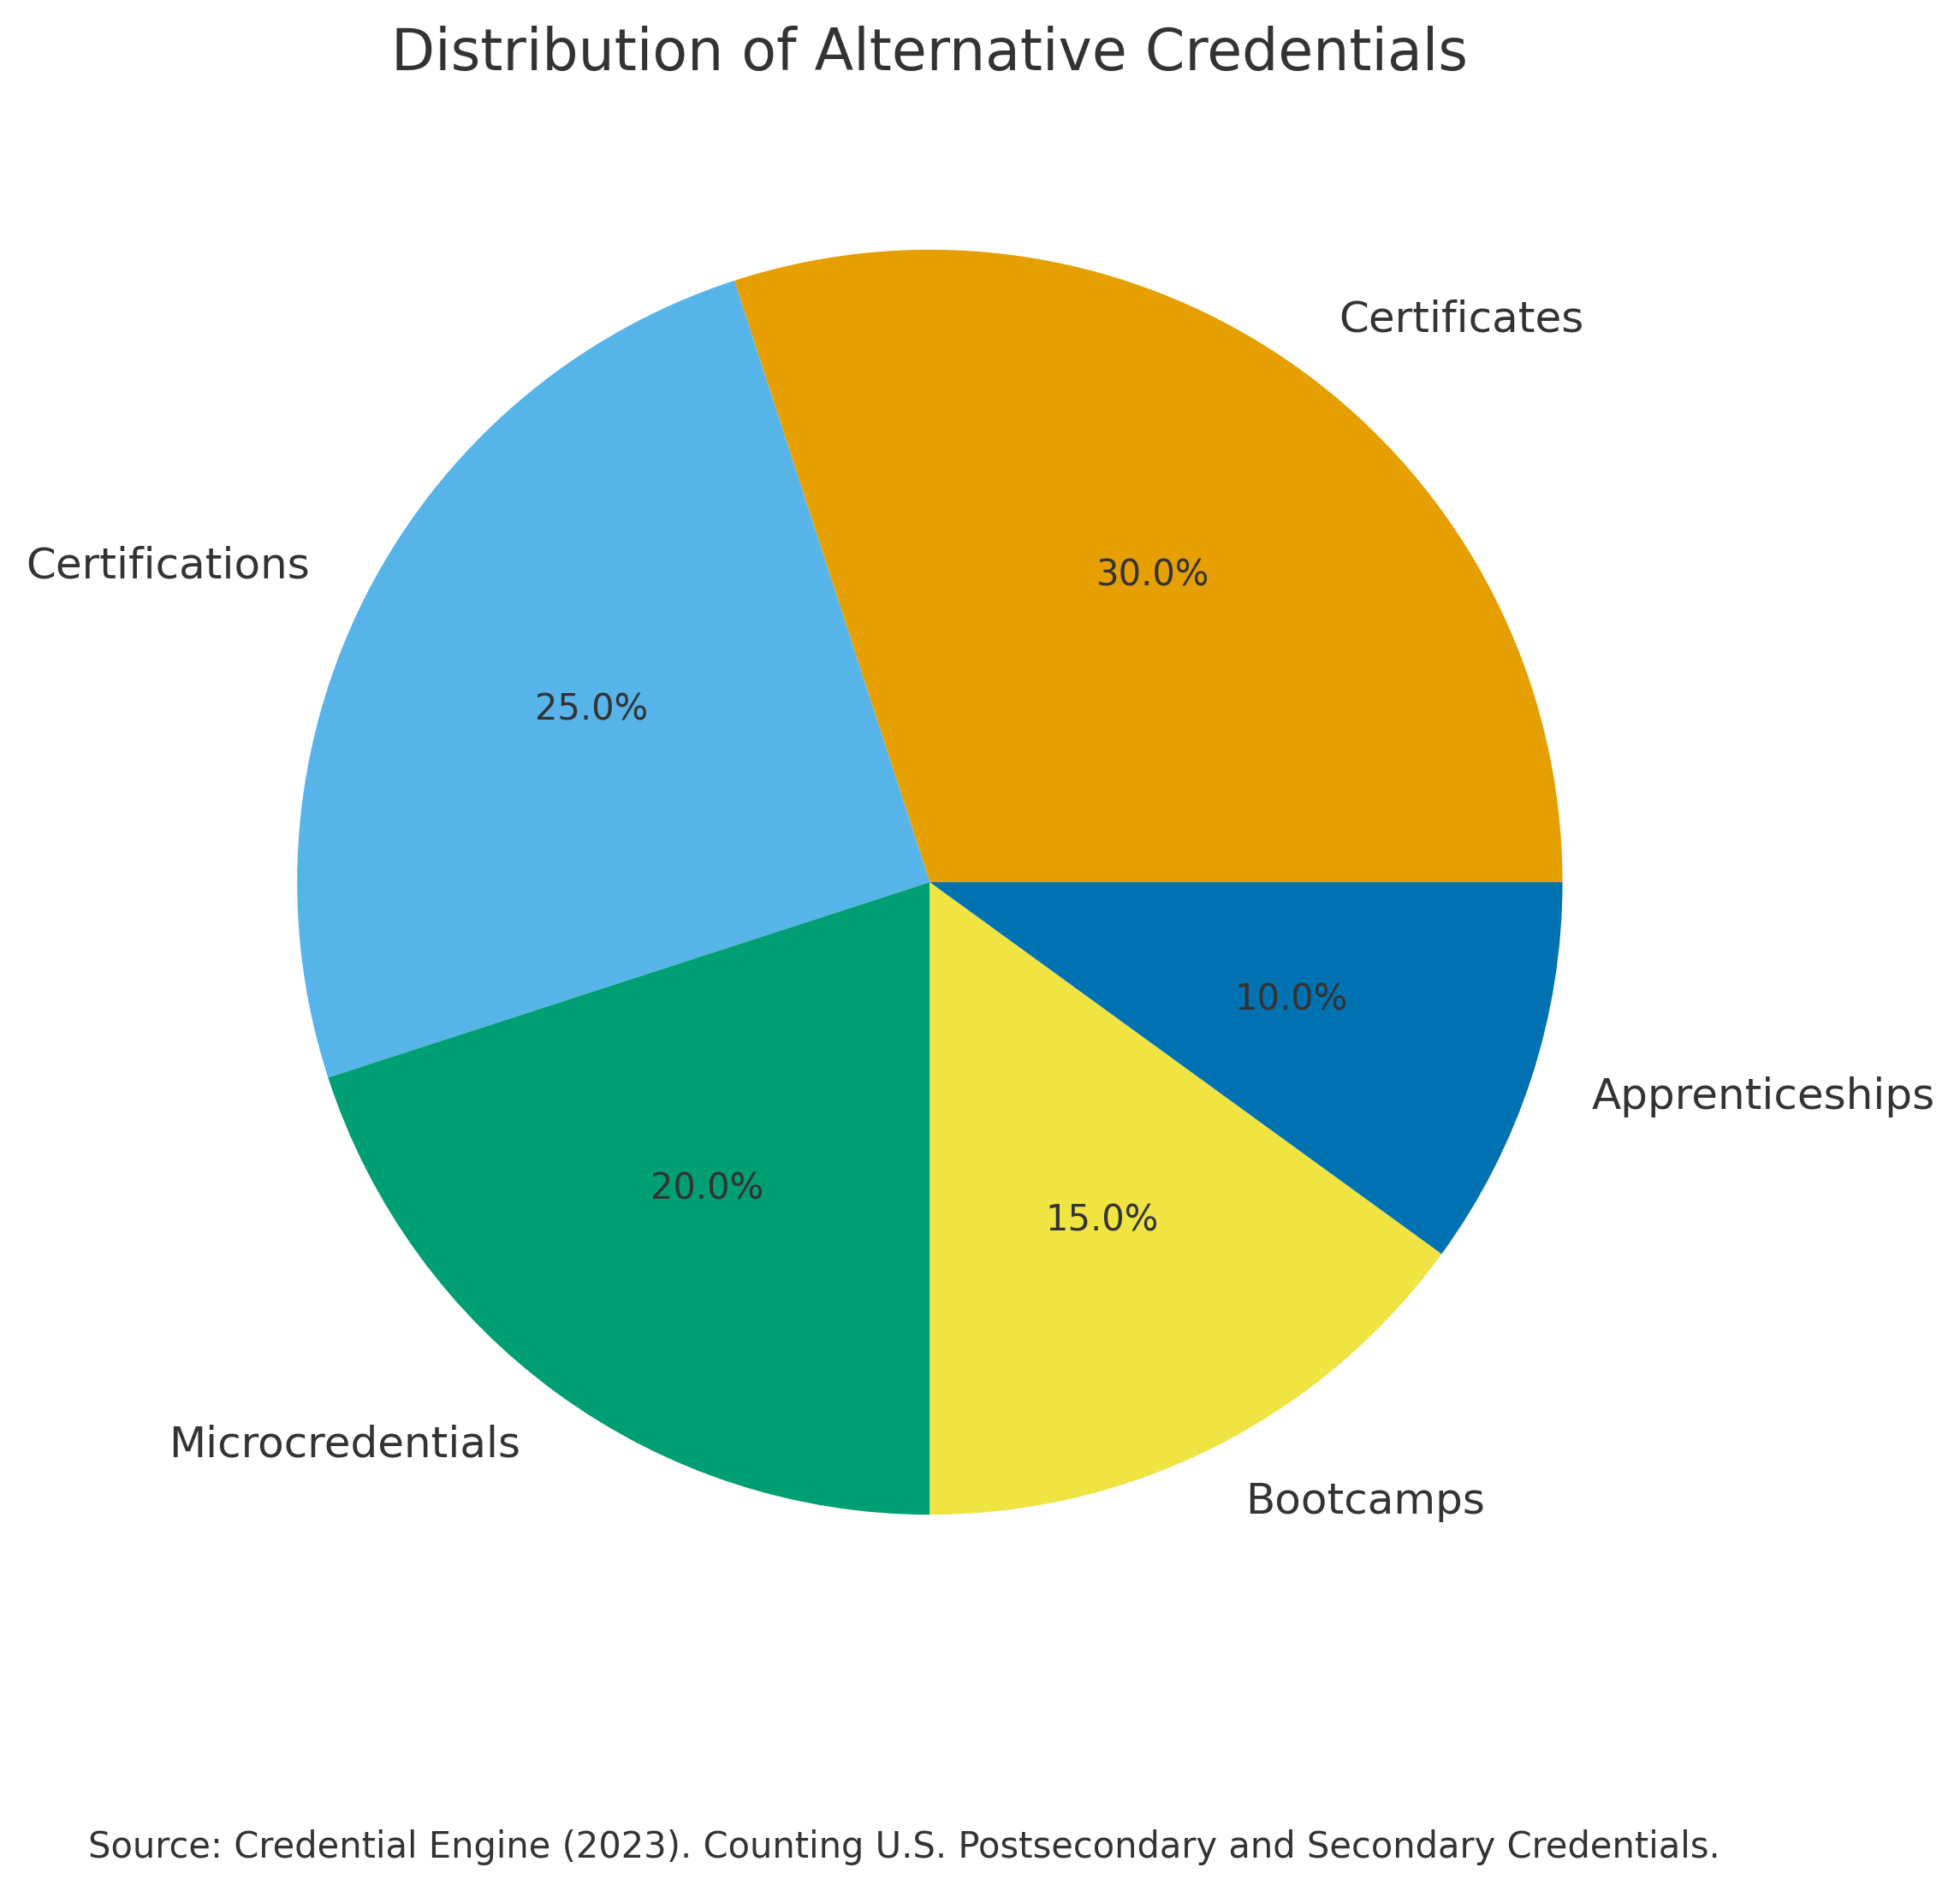
How Schools are Adapting – A Recalibration of Higher Education
The market for higher education alternative credentials is expected to grow by about USD 1.8 billion from 2025-2029, - non-credit training courses leadinggrowth(newsroom.technavio.org)
In the 2021-22 school year, over 1 million certificates (non-degree credentials) were awarded in the U.S., with almost 17,000 credential-issuers and over 600,000 credentials coming from non-academic providers (Education Commission of the States)
The alternative credentials market is expanding rapidly. Global market size was $18.83 billion in 2024 and is projected to reach $69.9 billion by 2032 (Fortune Business Insights)
Community colleges alone awarded 1.45 million credentials in 2022‑23, up 21% from 1.19 million in 2012‑13. (AACC)
Colleges are identifying high-demand roles: medical assistants, nursing assistants, heavy/tractor‑trailer drivers, etc., and matching credential pathways. Kentucky's report noted growing credential production in healthcare, computer science, and trades, including weld
Streamlined degree programs are also growing. OCP drafted and advocated for the passage of VETeach, a streamlined degree plan signed into law in 2025 to help veterans to efficiently launch a career in teaching/A-2722 permitted military medical training for credit towards becoming an LPN

Slide 11
Veterans Are Uniquely Suited To Meet Current Needs
Military experience directly aligns with logistics, operations, safety, and mission execution.
The increase to access and understanding of alternative pathways opens the door to positions that reduce time and money
Veterans bring experience in transport, maintenance, planning, and leadership, but lack accessible pathways to convert those skills into trucking ownership or management roles.
Many transitioning servicemembers cite a desire for entrepreneurship yet lack industry-specific business training.

Slide 12
New Jersey Pathways Initiative
This initiative, NJ Pathways to Career Opportunities: Aligning Education to Build an Innovative Workforce, brings together employers, industry associations, labor unions, education institutions, and workforce development partners to provide students and workers with the education and career pathways they need to find new careers and opportunities to achieve a competitive wage, and to ensure that employers have access to a highly skilled workforce to meet critical labor market needs.
Areas include Cyber, Healthcare, Research, and Supply Chain.
The Trucking Business Academy fills a critical national gap in workforce and veteran economic mobility.
A coordinated, evidence-informed model built with higher ed, VSOs, and industry.
Supports career launch, advancement, and business ownership—not just entry-level training.
Creates clear, credential-aligned pathways for veterans, spouses, and transitioning servicemembers.
Meets industry demand for more capable small fleet owners and strengthens the national supply chain.

Slide 13


Trucking Business Academy
What is it?
12-week online program to train CDL drivers to start their own trucking business
Completion certificate issued through Camden County College or Hudson County Community College
To earn their certificate, students must attend all class sessions and draft a viable business plan
NOT another CDL school, but rather a trucking small business incubator

Slide 14

Trucking Business Academy
Why do we all need it?
70%
of new trucking businesses fail in the first year
50%
that survive the first year ultimately fail
Inadequate
Capital/
Resilience
Regulatory
Violations
Deficient
Maintenance
Barriers to
Success
Include:

Slide 15

Trucking Business Academy
Why do veterans need it?
Veterans are employed in the trucking industry at twice the rate of the civilian population
Many veterans have experience operating and maintaining heavy equipment
Soft skills common to the military are in demand in the trucking industry: reliability, punctuality, professionalism, safety, honesty

Slide 16
Trucking Business Academy
What is the content?
Business Basics
Business Formation
Safety & Compliance
DOT Requirements
Insurance, Permits & Tax
Required/recommended coverage
Drafting a Business Plan
Balance Sheet, P&L, Budget
Driver Qualifications
Duty Status Logs
Necessary permits
Tax obligations and timing
Marketing
Finding your niche
Technology
Safety technology
Health & Wellness
Common physical and mental risk factors
Market research
Multi-channel planning
Business management software
Future technology
Planning for a healthy life on the road

Slide 17

Trucking Business Academy
What is the student contribution?
Students draft their own business plan
Individually tailored to each student’s vision
Incorporates all material covered in class
Budgeting is comprehensive and includes realistic estimates
Marries operational vision to related costs to ensure resilience
Can be leveraged to obtain financing

Slide 18

Trucking Business Academy
What is the impact of Artificial Intelligence (AI)?
Rise of autonomous vehicles is inevitable
Role of the driver will undoubtedly be marginalized
Trucking businesses, however, will remain in demand regardless of AI
Ownership is the key to long-term viability
Lots of “dumb money” is being spent on AI right now
New owner/operators do not need to be on the forefront
New owner/operators DO NEED to be prepared to jump when AI matures
Budget NOW for future cap ex

Slide 19


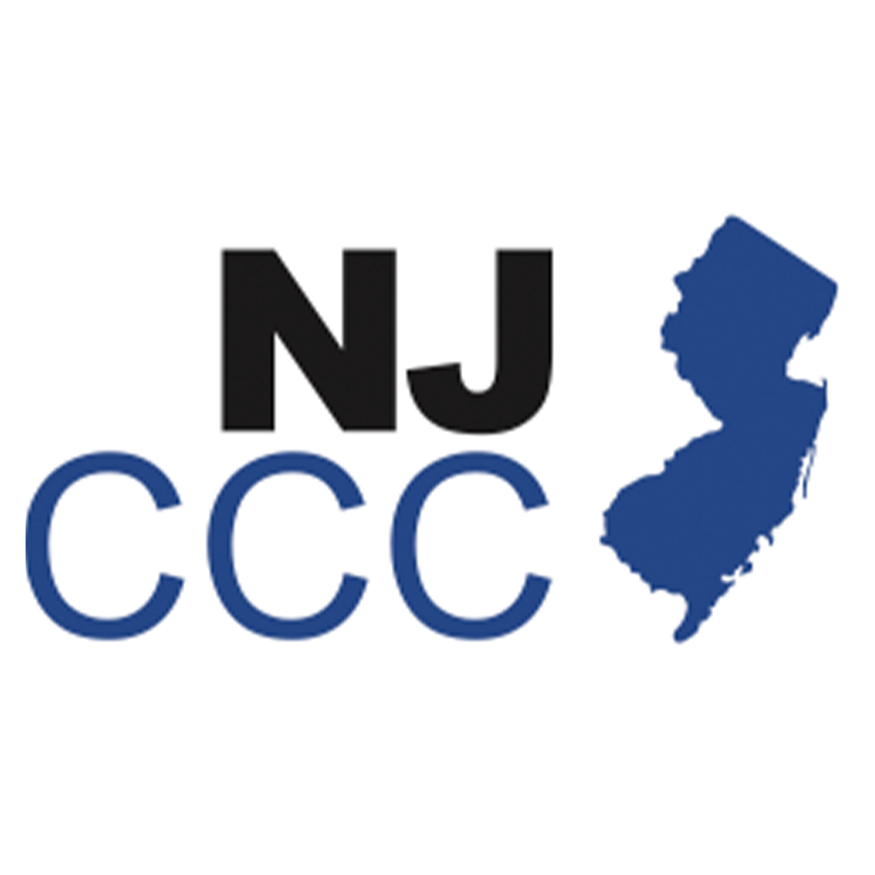

Trucking Business Academy
Who are the Partners?
Camden County College
Hudson County Community College
Dixon Center
African American Chamber of Commerce of New Jersey
Funding Provided by:
New Jersey Council of County Colleges

Slide 20

Questions?
Pathway Connection Executive Summary:
The non-credit Trucking Business Academy pilot officially launched on July 28, 2025, at both Camden County College and Hudson County Community College. This pilot represents a significant milestone in the collaborative effort to provide accessible, high-quality training for individuals interested in becoming owner-operators in the trucking industry. Currently, 13 students are enrolled and actively participating in the program across both institutions. These students are engaging with a curriculum specifically designed to build both their business and industry-specific skills, laying the foundation to become successful business owners in commercial trucking.
The pilot cohort serves as a valuable test group, allowing faculty and administrato to evaluate the effectiveness of the curriculum, instructional methods, and student engagement strategies. Feedback collected from this pilot will inform future enhancements to the program and ensure it remains aligned with both academic standards and

