Slide 1
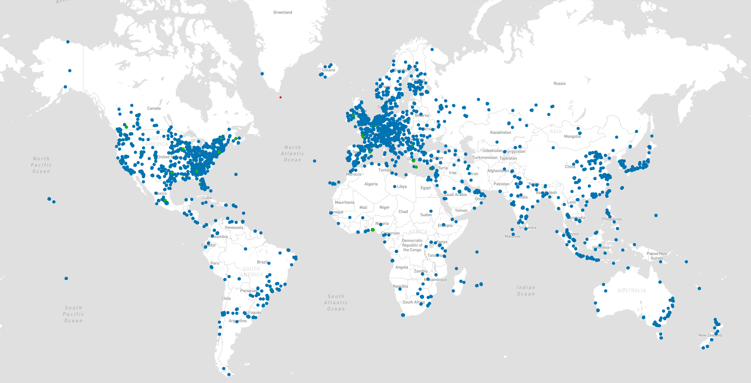
Global Data Centers- 11, 262 from 173 Countries

Slide 2
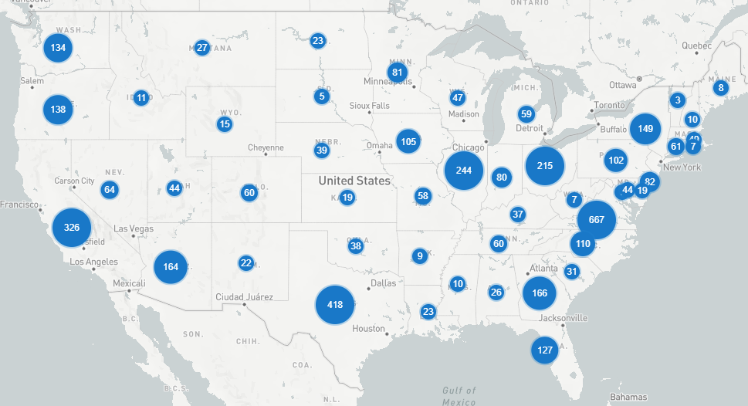
U.S. Data Centers- 4267 from 1,758 Operators

Slide 3
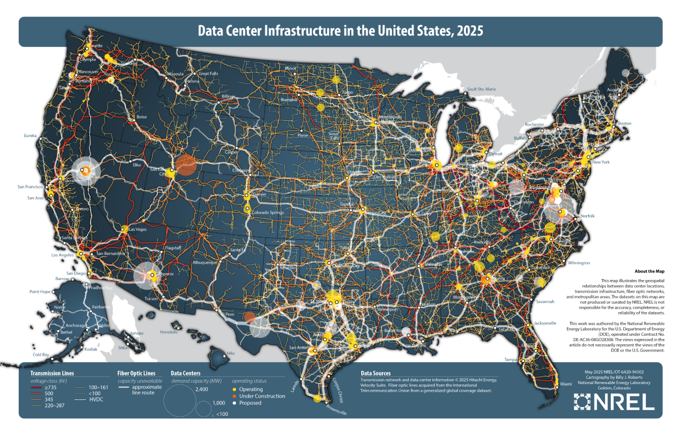
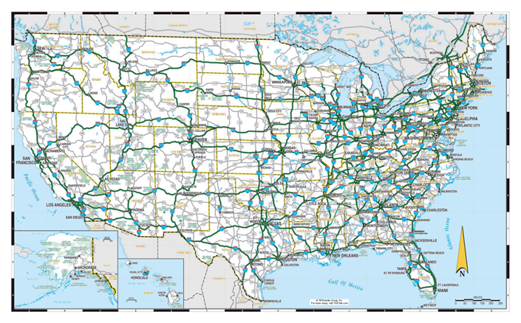

Slide 4
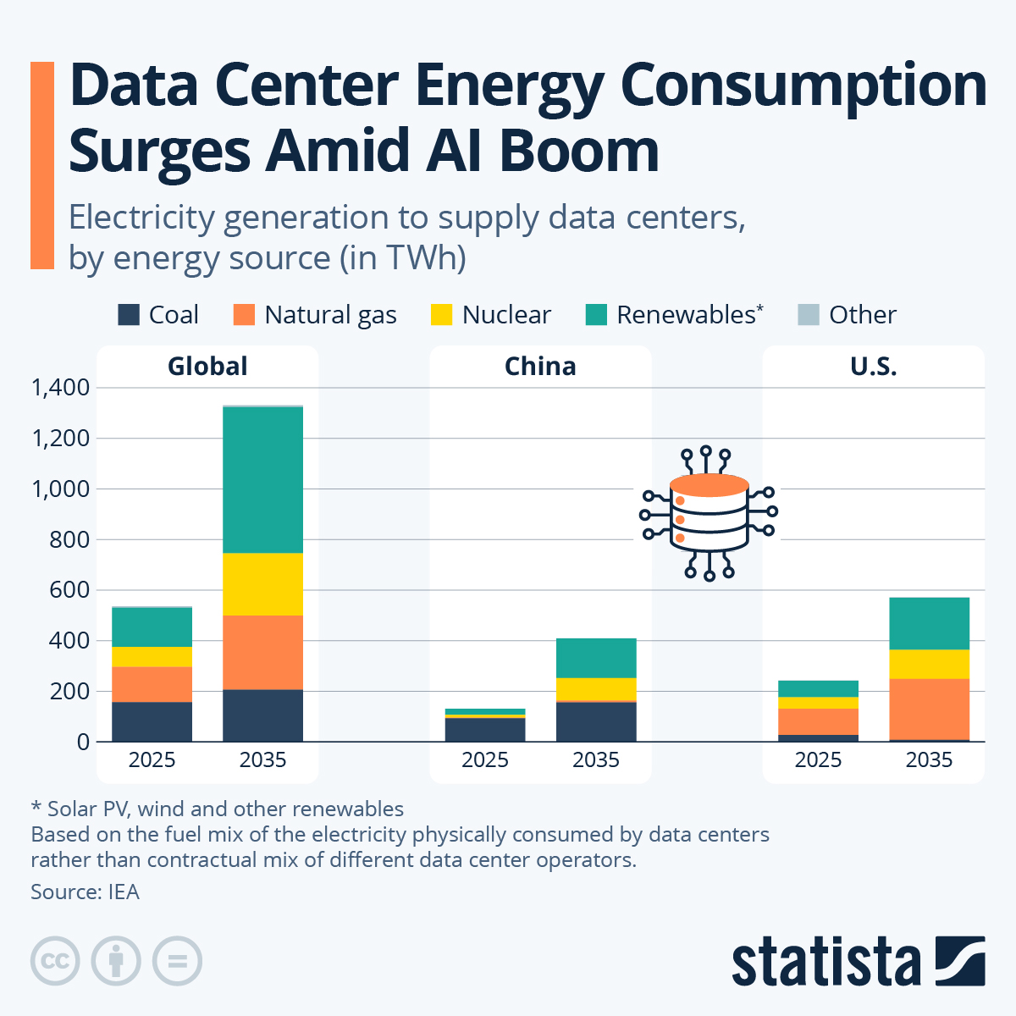
Data Center and AI Boom
Data center energy demand forecasted to soar nearly 300% through 2035
Industries that will be affected by data center growth in the United States
The data center boom is expected to significantly impact the following industries in the United States
Energy Sector
Construction and Real Estate
Technology and IT
Utilities
Transportation
These industries are expected to adapt to the growing demand for data centers, either by increasing capacity, improving infrastructure, or adjusting workforce needs to meet the new demands
Notes:
Industries that will be affected by data center growth in the United States
The data center boom is expected to significantly impact the following industries in the United States:
Energy Sector: The demand for energy to power data centers is increasing, leading to a potential shift in energy consumption patterns and the need for more efficient energy infrastructure.
Construction and Real Estate: The construction industry is seeing a surge in demand for land and building permits for data centers, which is reshaping the construction landscape and increasing the need for skilled labor.
Technology and IT: The growth of AI and high-performance computing applications is driving the demand for data centers, which are the backbone of modern technological advancement.
Utilities: The need for reliable power sources is becoming more critical as data centers require consistent power availability to operate efficiently.
Transportation: The logistics and transportation sectors are likely to be affected by the increased demand for data center infrastructure and the need for efficient transportation solutions.
These industries are expected to adapt to the growing demand for data centers, either by increasing capacity, improving infrastructure, or adjusting workforce needs to meet the new demands
AI companies have been racing to build more powerful data centers, helping to drive global investment in the facilities up to $580 billion this year. That’s more than the world spends finding new supplies of oil.

